Slide 1
Midlakes Hy-Tek Clinic 2010
Jeff Lowell, Assistant Principal, Interlake High School
  Past Coaching Experience:
    Mercer Island HS
    Mercerwood Shore Club
  Past President, WISCA
  Zone 8 Rep, NISCA
  Over 16years experience with HyTek programs
  7 years as instructor for Midlakes
Contact Information
  C: 425-495-5318 E: jefflowell@speakeasy.net

Slide 2
Midlakes Hy-Tek Clinic 2010
Eric Bartleson, General Manager, NHSTC
  Coaching Experience:
    Newport HS
    Newport Hills Swim and Tennis Club
  Treasurer, WISCA
  Over 16years experience with HyTek programs
  7 years as instructor for Midlakes
Contact Information
  Work: 425-746-9510
  Eric@nhstc.com

Slide 3
Introduction: This workshop is geared for summer league coaches/volunteers that may not be familiar with TEAM MANAGER. Please ask lots of questions and we will do our best to help.
Some information for this presentation copied from http://www.hy-tekltd.com/

Slide 4
Workshop Plan
  Timeline:
6:00 - 6:45 pm Team Mgr Training
6:45 – 7:30 pm Meet Mgr Training
7:30 – 9:00 pm Open Session

Slide 5
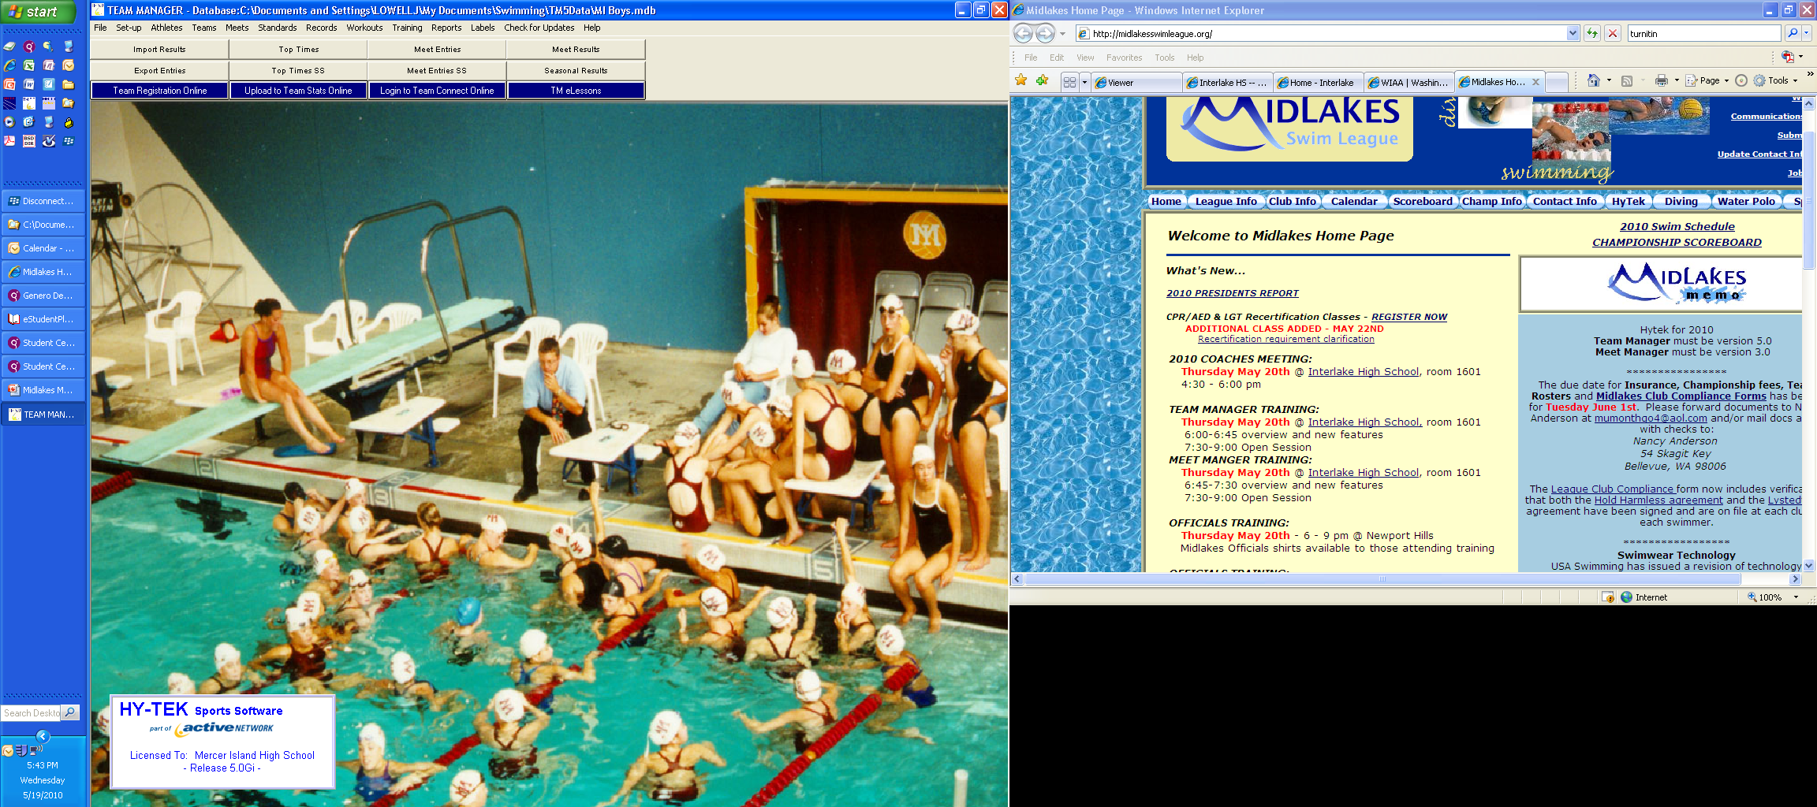
Team Manager

Slide 6
Why Team Manager?
designed for:
  managing and tracking administrative information
  managing and tracking administrative performance information
for your club, school, or swim team.
It also…..

Slide 7
makes entering a meet easy!
Just specify a meet entry qualification time (if any) and TM will list all eligible swimmers and events right on the screen indicated with their best times.
You can even filter that list from a previously defined "Pre-Entered" list of swimmers so that only swimmers that have declared that they will be able to attend the meet will be on the list!
  Just click on the events to be swum by each swimmer!
It's easy, fast, and accurate.
TM will also pick your Best Relay by evaluating eligible swimmers' times and actually putting together the relay for you - with one mouse click!

Slide 8
Award / Improvement Labels
..... Let TEAM MANAGER print a label for each swimmer that "improved" his/her time by an amount that you specify.
Entry labels
..... Print cards that reflect entries for an upcoming meet.
Journal / Recruiting
..... This feature lets you enter any text (notes) to be stored into your database by date and title as well as enter recruiting information for athletes.

Slide 9
Other information about the product
Sign Up for News Bulletins at www.hy-tekltd.com
Stay Current with product Releases
  How to Get Help
  Use the Product / Internet Help or User Guide
FREE Tech Support via Email or Telephone for Current Releases
FedEx Shipping with Email Tracking
Sales Office: Toll Free 866.456.5111 & sales@hy-tekltd.com
Information pulled from http://www.hy-tekltd.com/

Slide 10
Pricing and Order Information
When you upgrade to TM 5.0
  automatically receive options you have in your current Hy-Tek Team Management product release.
    For example, if you have the Awards Label or the Record/Time Standards options in your current TM II, Win-TM or Dos-TM version, then you will AUTOMATICALLY receive those options when you upgrade to TM 4.0.
  THE CURRENT VERSION IS TM 5.0 lg

Slide 11
The TEAM MANAGER Start-Up…
  comes ready to help you manage most of your team's administrative and performance oriented tasks.
  you can purchase options for TEAM MANAGER to expand its capabilities.

Slide 12
Workshop Plan
Creating your team
Creating a meet
Miscellaneous
E-lessons
Updating the Program

Slide 13
Creating your team
Age up date – set to 6/15/2010
  Set Up / Preferences / System preference – change the date
Entering athletes –
  Creating custom fields
  Activating/Inactivating Athletes
  Universal moving of a set of athletes
Creating A/B teams
Creating a Team Records/BDQ/League Records files – import/export

Slide 14
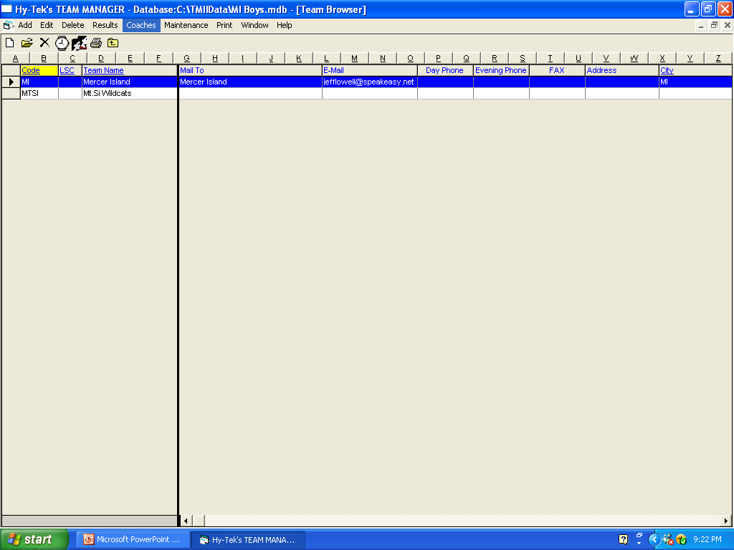
In the team menu make sure to complete two items:
Add your team name – include updated contact information. Be sure to include ALL telephone and email addresses.
Add updated coaching information in the coach menu. Go to Team/Coaches to enter all coach information. Please record all certifications including expiration dates.
THIS IS VERY IMPORTANT – ESPECIALLY THE CONTACTS
Correct coach and team contact information will make the end of the season run smoothly.

Slide 15
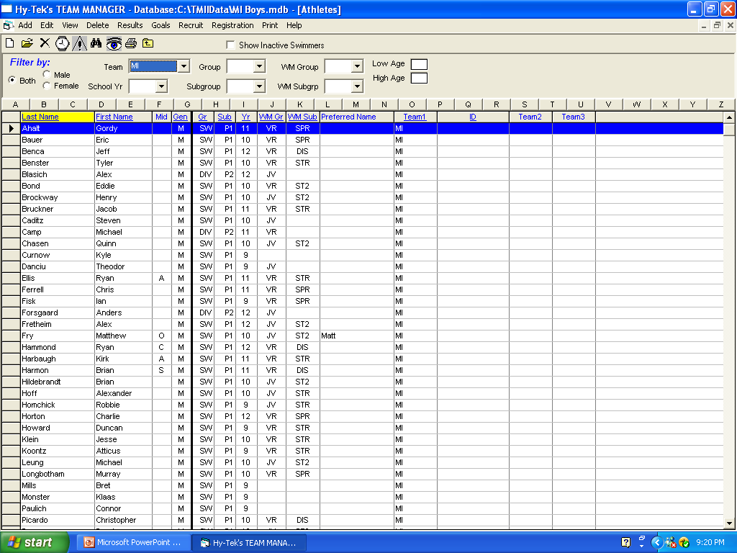
This is the athlete menu
Enter in all information.
You do not need to put an ID # in or build and ID as this is for USS swimming only or use the registration button.
USE THE CUSTOM TAB. (To set this tab up go to Set-up/Athlete Custom Fields.)
  These fields can be any information you would like to have about the athlete and/or family (such as Parent volunteer job or T-shirt size).
A and B Team Set up
The recruiting button has other info that you can add about your swimmers.

Slide 16
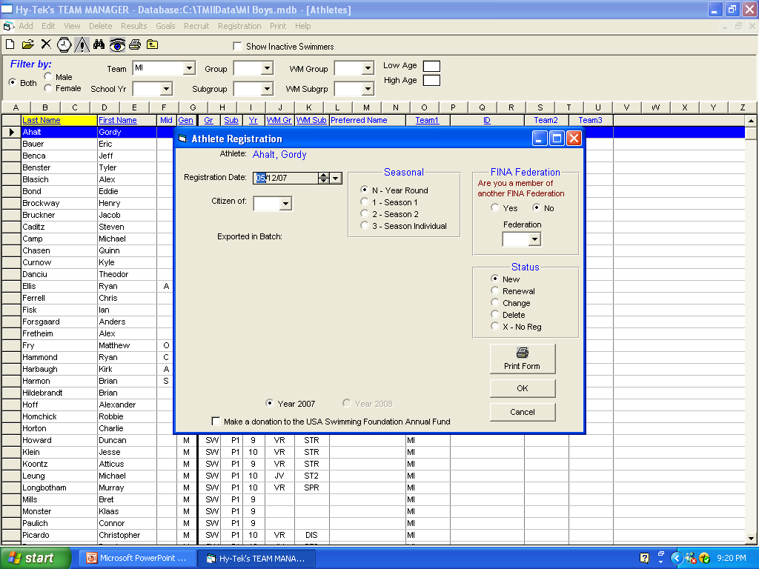
Choosing an athlete gives the option of creating a registration sheet utilizing stored information.
This option could come in handy to track members from year to year.

Slide 17
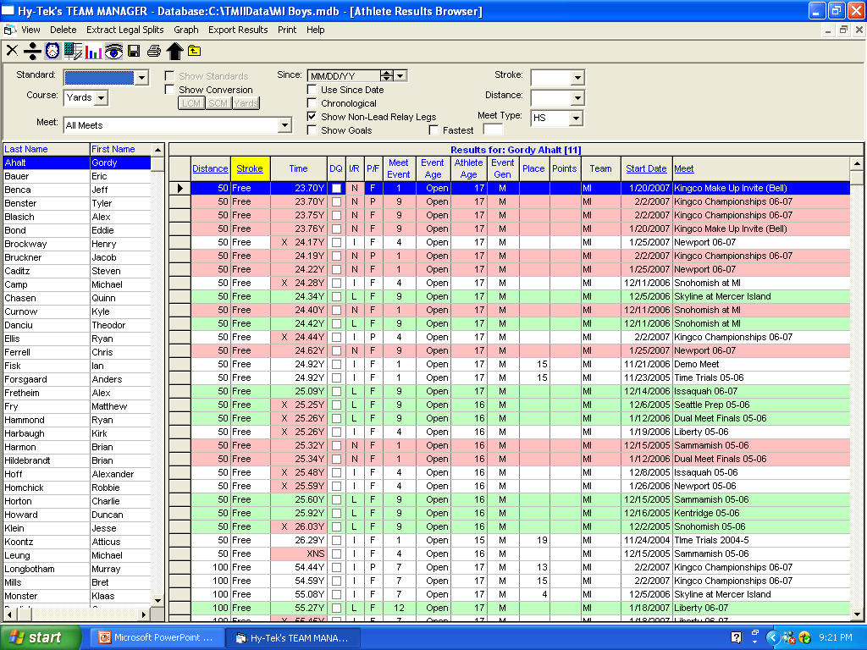
In the athlete/results menu – you can browse an individual’s results. When a mistake is made in results, this is where the mistake is corrected.

Slide 18
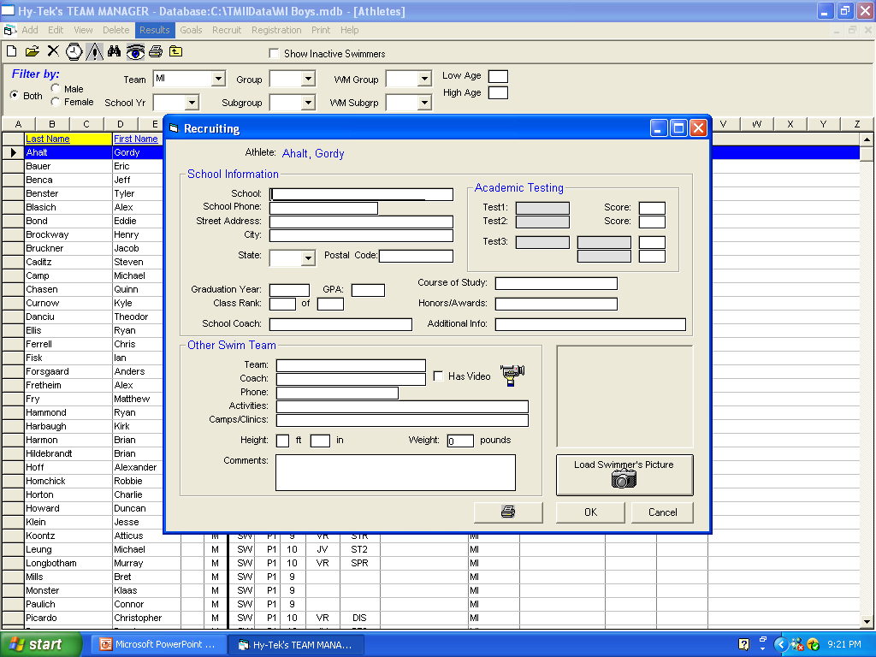
  You can add a photo of the swimmer. It takes *.bmp format. You may have to play with this feature to get the photo the correct size.
To finish entering the swimmer hit OK and you can move onto the next swimmer.
To exit out of the Athlete information form hit Cancel.
This is the recruiting menu

Slide 19
Universal Moving
To move an entire set of athletes:

Slide 20
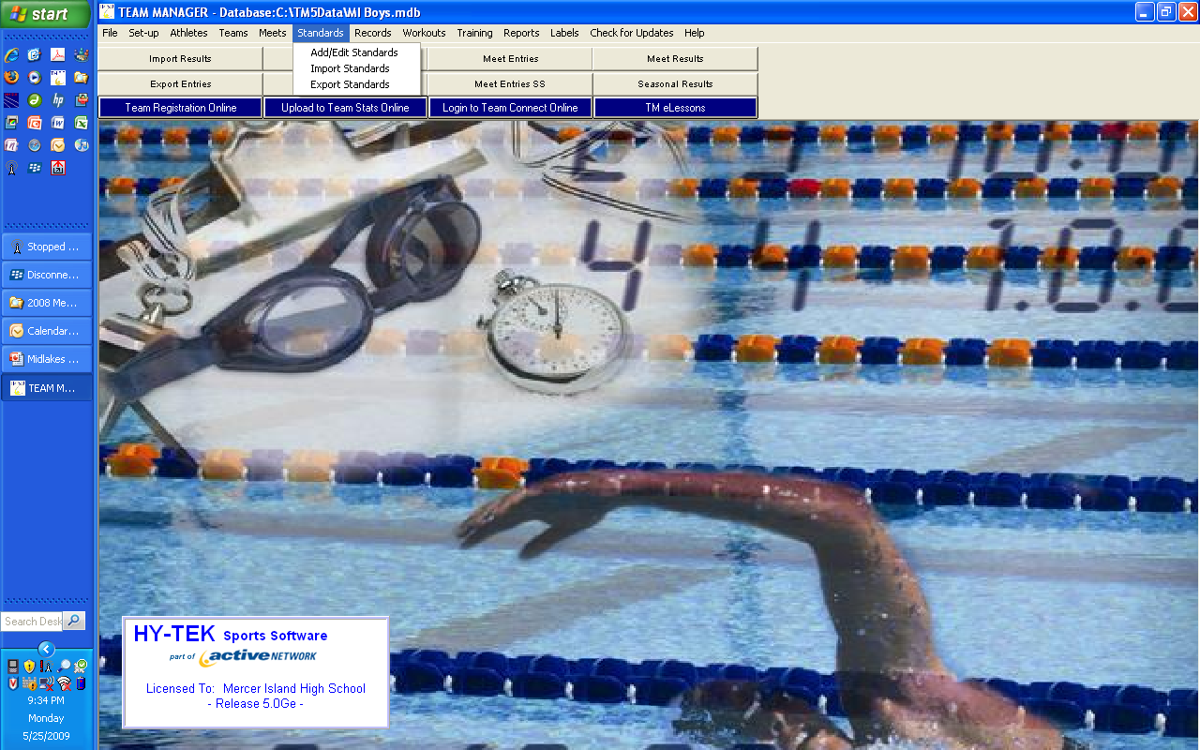
If you are starting with no Time Standards then you will:
  Go to Standard/import file name temStd.st2.
  The file will have both meters and yards time standards.
If you are starting with last year’s Time Standards then you will:
  Edit the old standards.
  go to Standards Add/Edit. Change the standards that need updating.

Slide 21
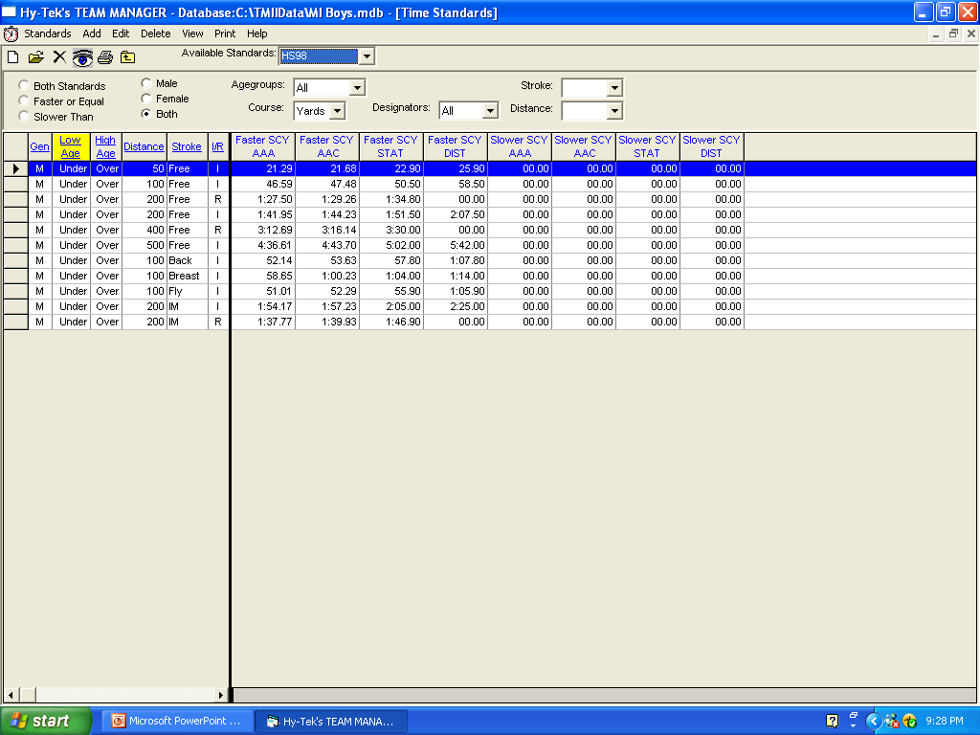
This is what the screen will look like when editing time standards – be sure to edit for both yards and meters.

Slide 22
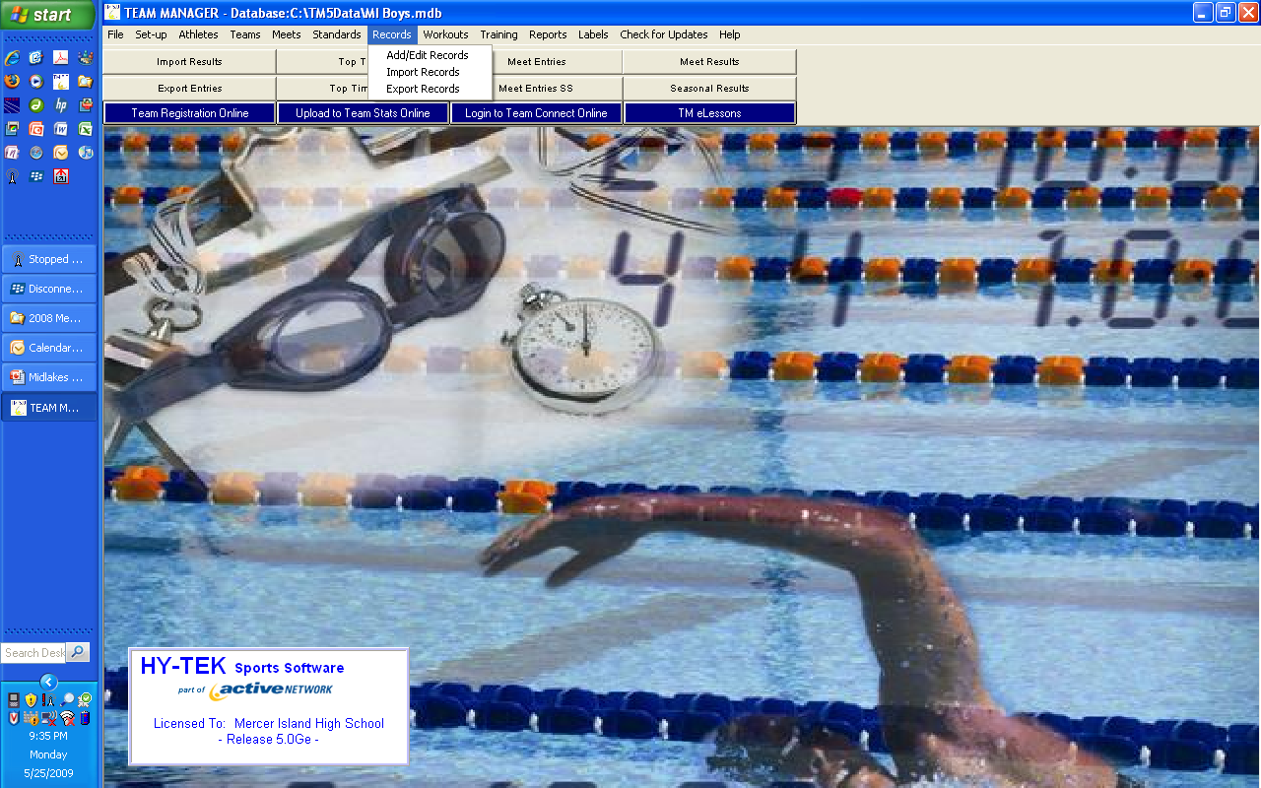
RECORDS
If you are starting with no records you will need to import the current Midlakes list.
  Go to Records/import/file – look for record-y.rec to import the current Midlakes records.
  You will have to enter Team Records if they are not in your database.
    To enter you team record go to Records/Add/Edit then records/create new record set.

Slide 23
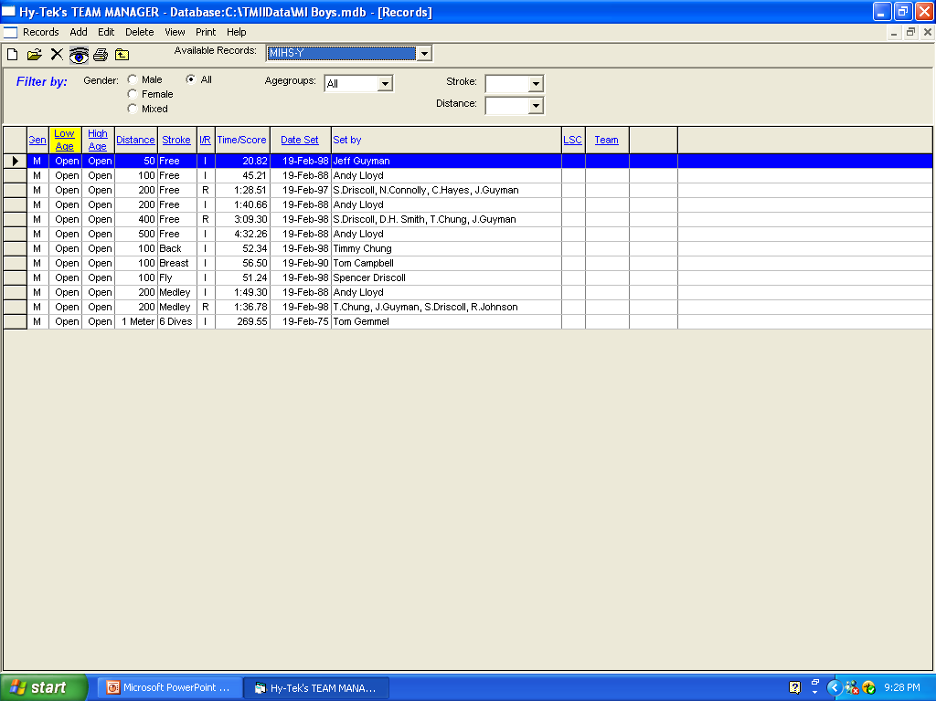
The program will only show one set of records at a time so once you have entered this new record set you should have 2 sets to chose from.
Select the correct set by going to the Available Records pull down menu and select from the list.
To fix an entered record double click on the record and them make the changes in the form that pops up.
You can change the name-time-date-team by just clicking on the relevant box.

Slide 24
Records / BDQ Import
Go to Records/Import Records
  Choose your file – import
Go to Standards / Import Standards
  Choose your file - import

Slide 25
Creating a meet
Dual/Division Champs/League Champs events
Pre-entering swimmer in the meet
Entering swimmers by Name/Event
Selecting exhibition swimmers
Assignment of lanes/heats in team manager
Exporting entries to Meet Manager
Maximum entries
    Dual Meets 2 Rel/2 Individual or 1 Rel/3 Individual
    Division Champs 2 Rel/1 Ind or 1 Rel/2 Ind or 3 Ind
    League Champs 2 Rel/1 Ind or 1 Rel/2 Ind or 2 Ind

Slide 26
Note
max for a dual meet is 4 swims,
max for a Championship meet is 3 swims between Division and League Champs.
The only exception is 3 swims at Division Champs and One relay swim at League Champs.
There is an easy to read chart in the Operating Plan

Slide 27
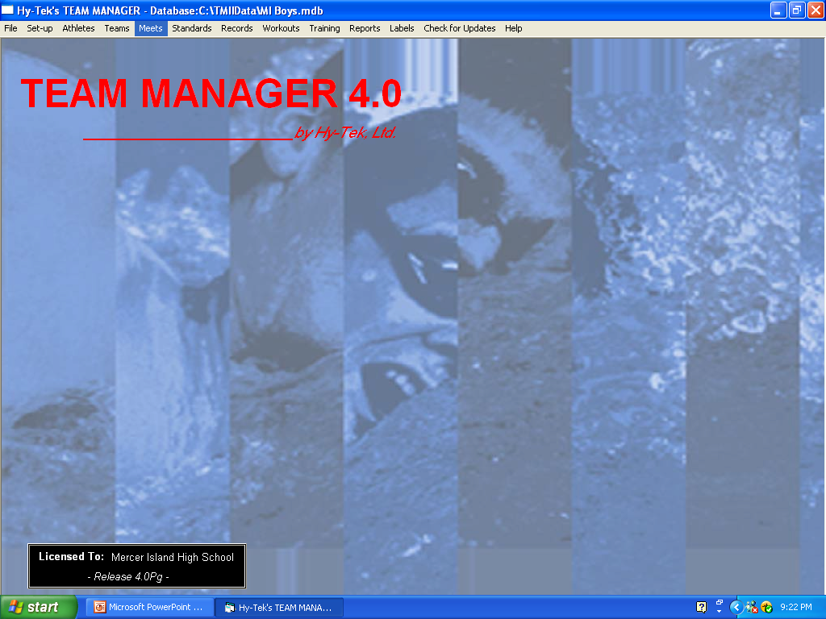
Adding meets
  Go to Meets/add - enter meet information

Slide 28
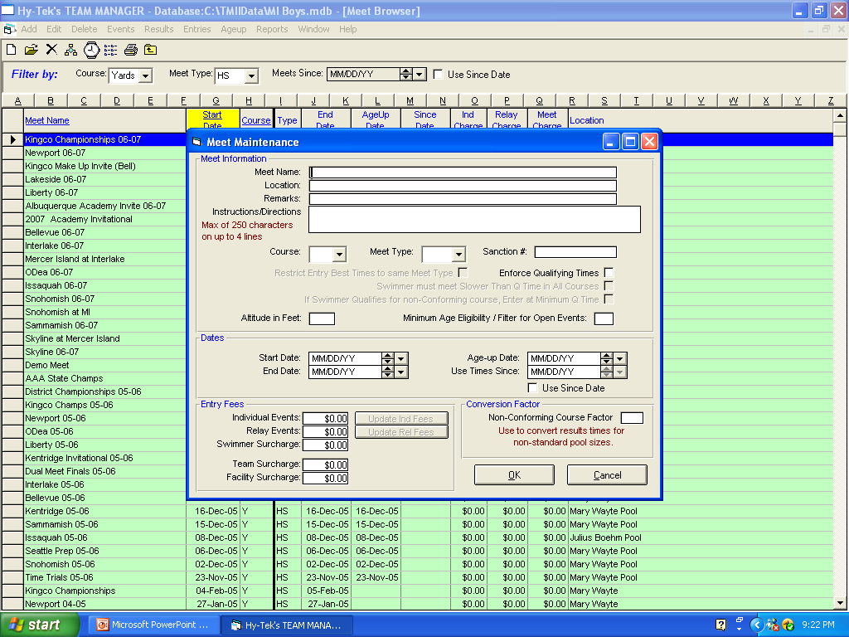
BE SURE TO PUT THE CORRECT COURSE (Y or M and meet type = Age group).
Other considerations:
Start Date and Age up date should be 6/15/2009 if you entered this in the systems preferences section.
Use TIMES SINCE – will limit entry times from date selected further.
  If you leave it unchecked then the meet will use the swimmers best time from all years for entries and reports.

Slide 29
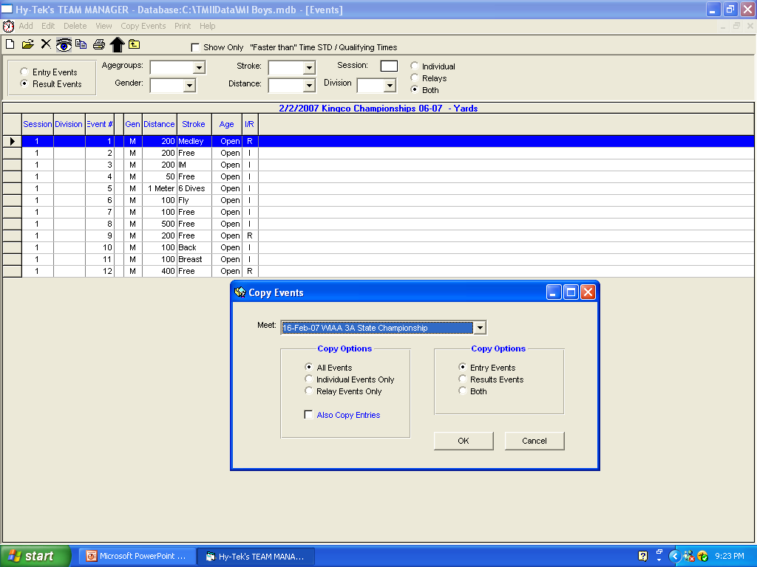
Adding events to your meet.
  This can be done manually – go to events/add then check the correct boxes for the event.
    For qualifying times the designator should be selected from the pull down menu.
  The age groups for Midlakes are 8&U, 9-10, 11-12, 13-14, 15&Over be sure to use these age ranges for all of your meets.
  The Program will automatically switch from female to male as you enter events.
Go to copy events then select a meet from the list that has been completed.
Choose to copy both entry and result events.
You can also import from a file. Go to File/Import/ Meet Events. Choose your file with your events and follow the directions.
You should be sure to do this for the League championship meet.
import the file called MmleagueEvents.hyv

Slide 30
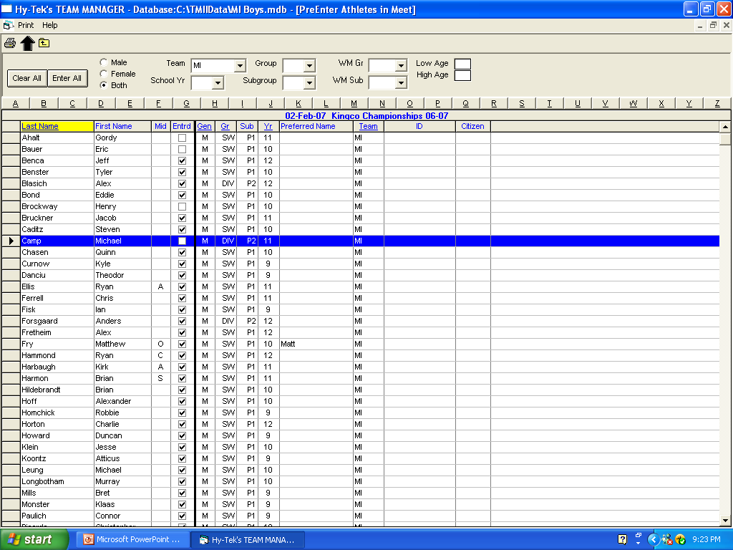
In the Pre-enter athletes menu – coaches can set up the meet with only those athletes who will be in town on the day of the meet. Athletes who are clicked are entered in the meet

Slide 31
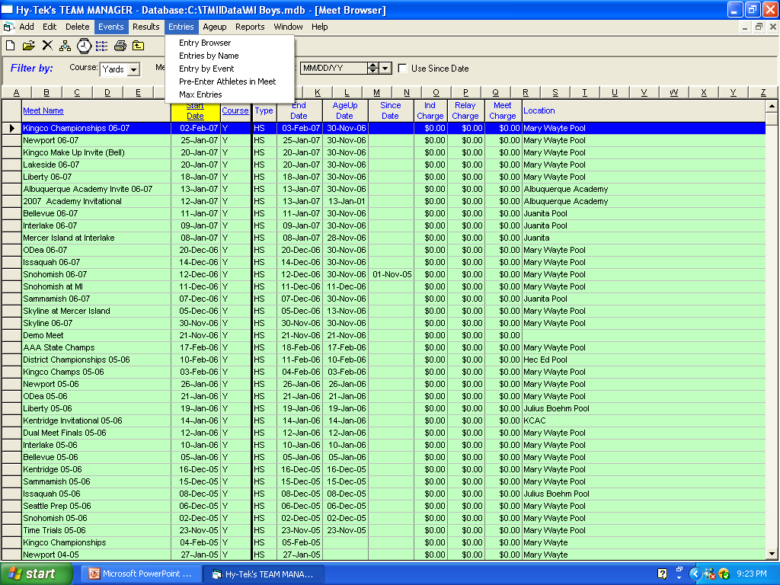
Maximum entries – set combined to FOUR
  program will beep at you if you try to enter an athlete in more than four events.
    The rule for Midlakes = a swimmer can be entered, in a dual meet in 3 individual and 1 relay or 2 Individual and 2 Relays.
      ALL EVENTS EXHIBITION AND SCORING COUNT TO THIS TOTAL
    For the Championships - swimmer is limited to 3 events
    the midlakes hand book has entry options for Division and League Champs.
  Hit OK and add your next meet. Hit cancel to exit the form.

Slide 32
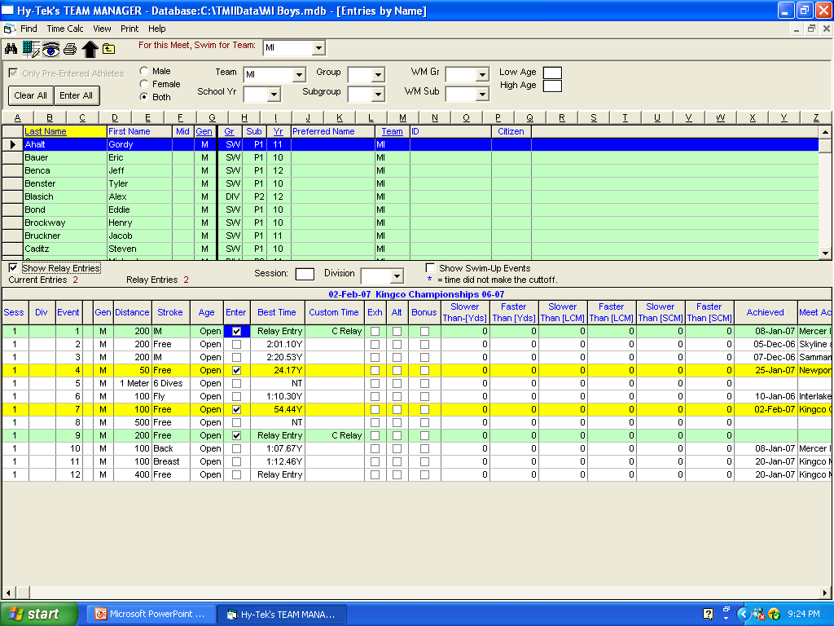
FOR MEET ENTRIES
Highlight the meet you want.
Go to entries and select Name or Event
  Experiment with each to find which one works for you.
  You will need to select your team prior to entering any swimmers in the meet
  To make this default to your team
    go to Set-up/Favorite Filters Menu/Add and enter your team name to the Favorite Name, course = yards or meter, Meet Type = Age Group. Hit OK then Hit Set Default. Your team should be highlighted in yellow.
This is the Entries by athlete menu – you can enter your relays from this menu…

Slide 33
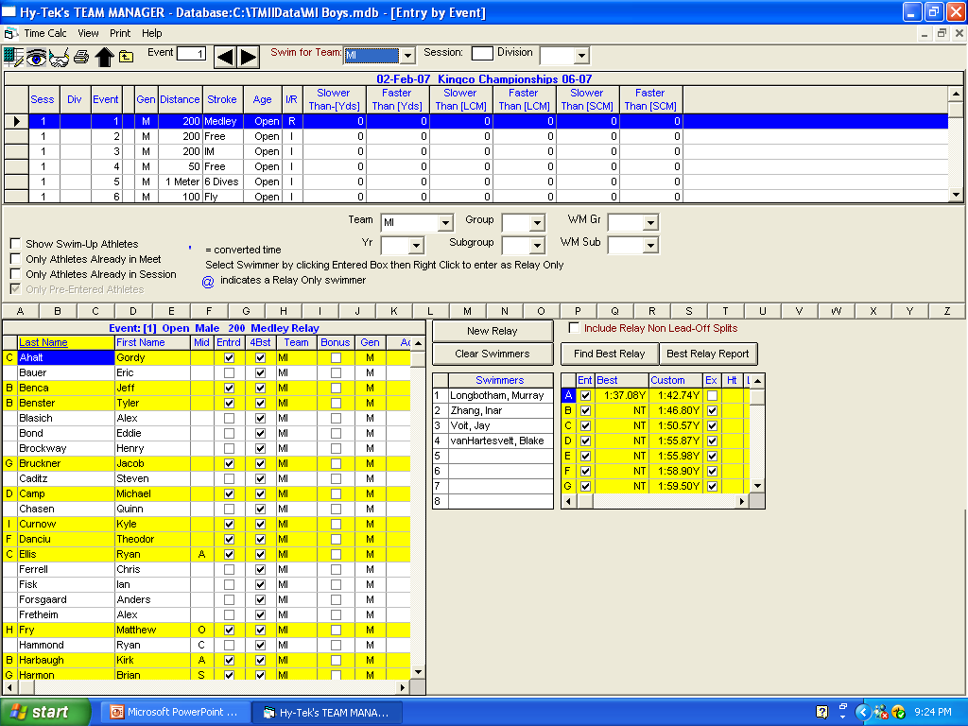
Heat and lane can still be entered
When entering relays by event, you can use the database to help find the best relay

Slide 34
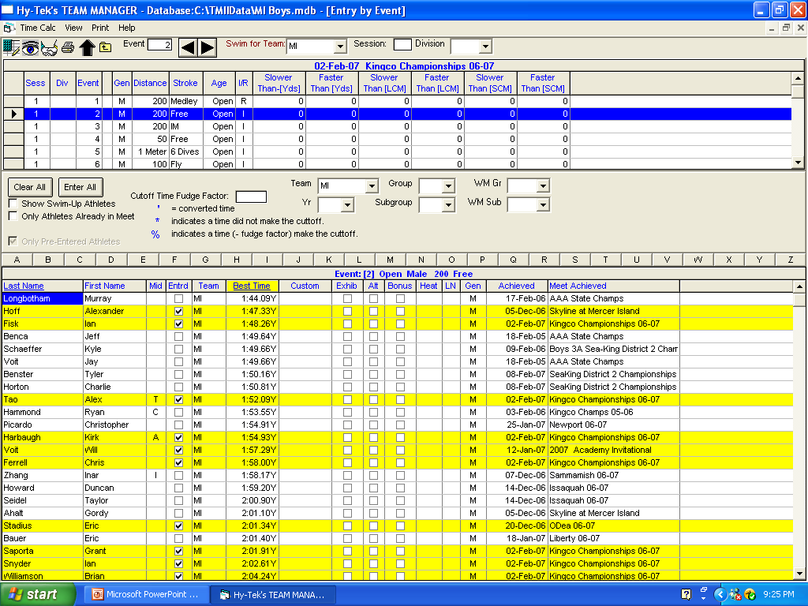
In the entries by event, all swimmers eligible will be listed.
  Click on the ones you want to enter.
  Seed Time
  Heat/Lane assignment
For relays
  Add all of the relay A/B/C check relays as ex if needed and enter the heat/lane for each.
  You can then enter swimmers into each relay.
Note: By entering in the Heat and Lane for each swimmer you will make importing to Meet Manager and seeding of the meet run smoothly.
Be sure to talk with the other coach about exhibition heats so that your meets will match up.
If you don’t, when you import your entries some of them will not get entered and the person running meet manager will have to enter swimmers manually

Slide 35
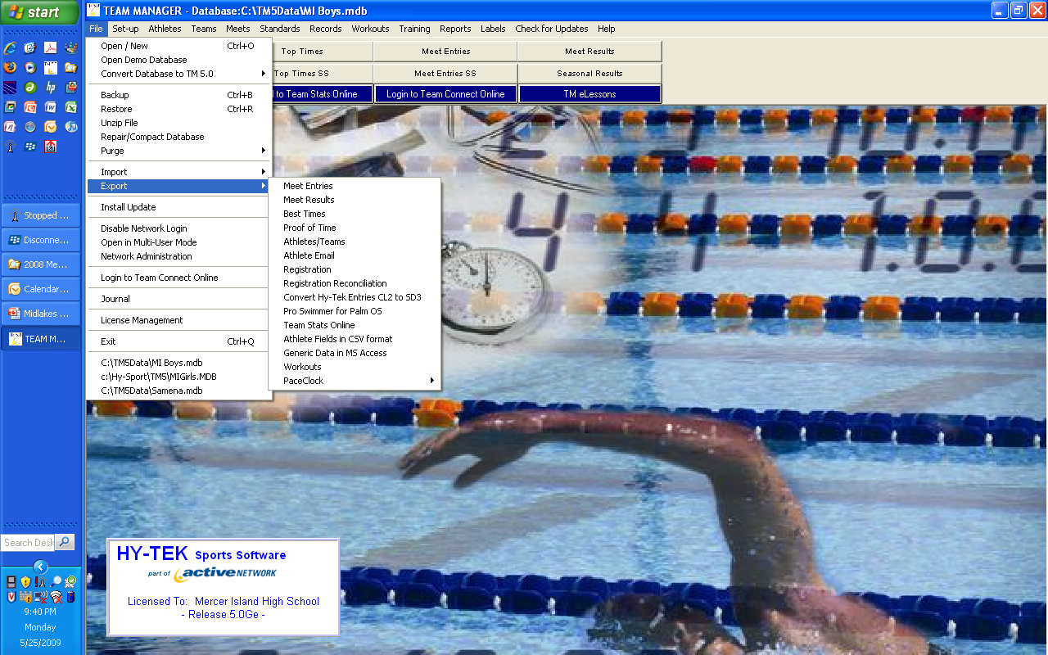
Exporting Meet entries/Athletes
Put a disk in the A drive and go to File/Export/Meet Entries.
Select the meet you wish to export (make sure Export Relays is checked). Hit OK
Go to File/Export/Athletes/Team.
  Select your Team and check All.
  Hit OK.
  This makes it easier to add a swimmer during the meet for the person running meet manager.
  Note: those running Meet Manager Import both files prior to the start of the meet.
Importing Meet Results after a meet.
Put meet disk in the A drive and go to File/Import/Meet Results
Select the results file you want.
  It will be a cfile#.cls.
  See that you have selected the correct meet by looking at meet name and date. Select Import Relays. And All Courses.
ON MEET DAY

Slide 36
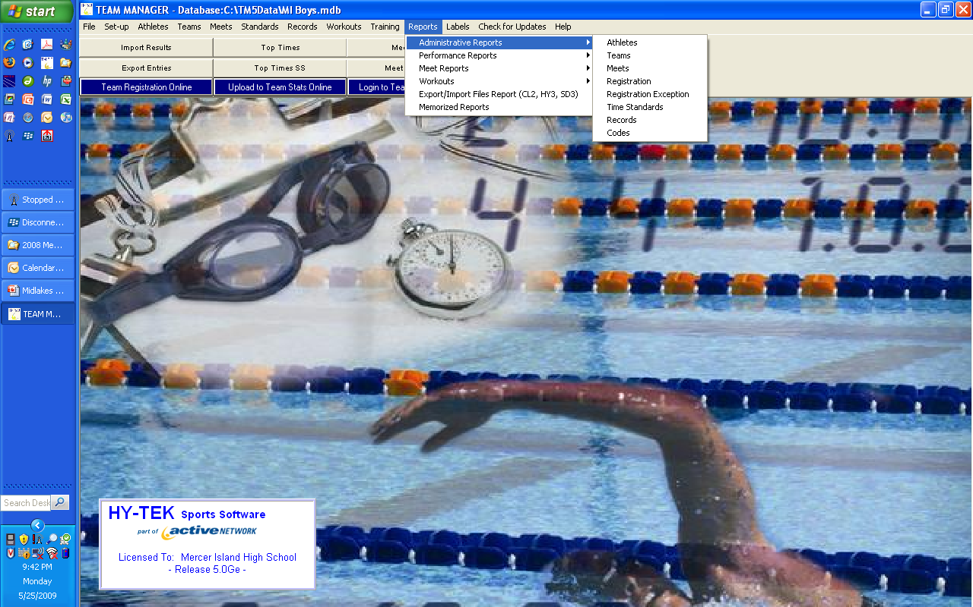
Play with Reports. Here are samples of many you will use.
There are many easy to use administrative reports to help with athlete tracking.

Slide 37
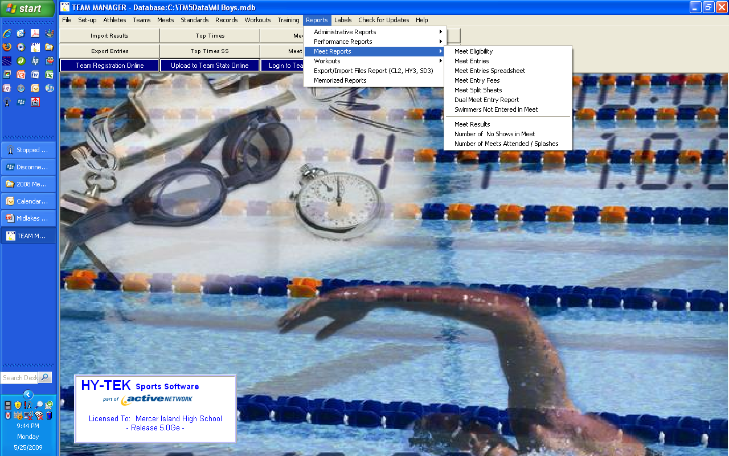
The Meet Reports will be very useful for the coaches
Meet Eligibility Report – Go to Reports/Meet Reports/Meet Eligibility. Select the group/ sex / age you want. (check Indicate converted times if you have any results from a meter pool)
Meet Entries Report – Go to Reports/Meet Reports/Meet Entries Select the event filters you want for the report and how you want the report sorted.

Slide 38
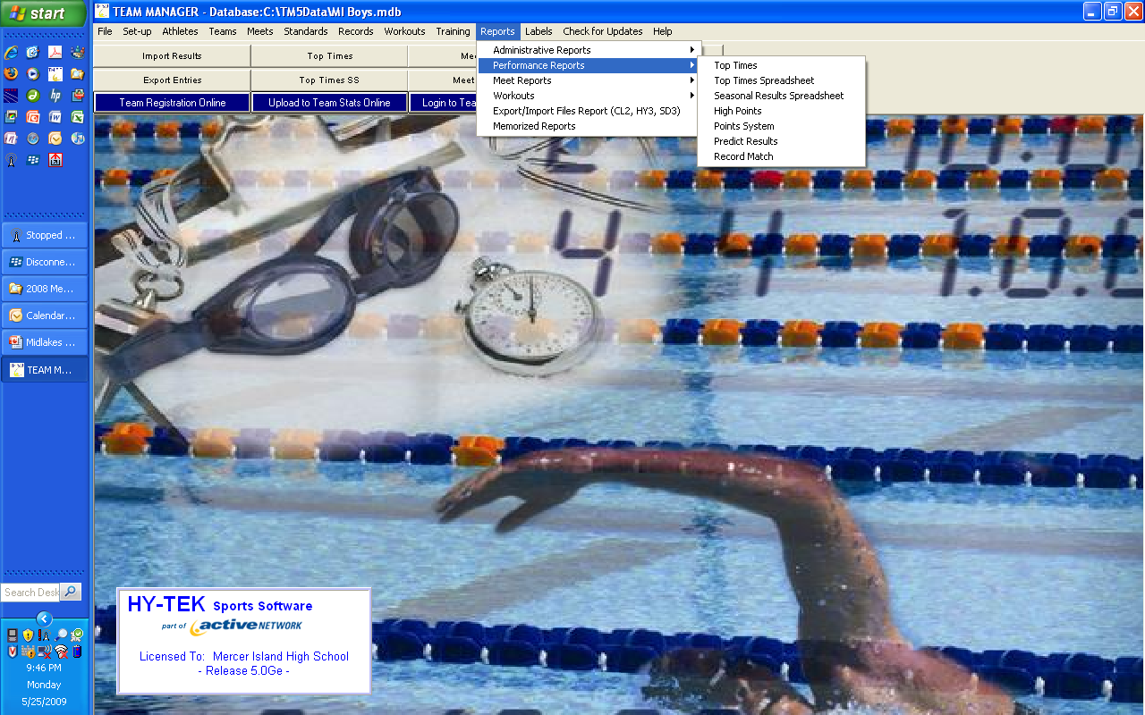
The Performance Reports will be very useful for the coaches
Top Times Spreadsheet – Go To Reports/performance/Top times spreadsheet. All meet, use the since date to restrict the best times. Under the Age Grp tab select custom for the report to list only the events that your team swims. Check course options YO
These are just a sample of the many reports you can print.

Slide 39
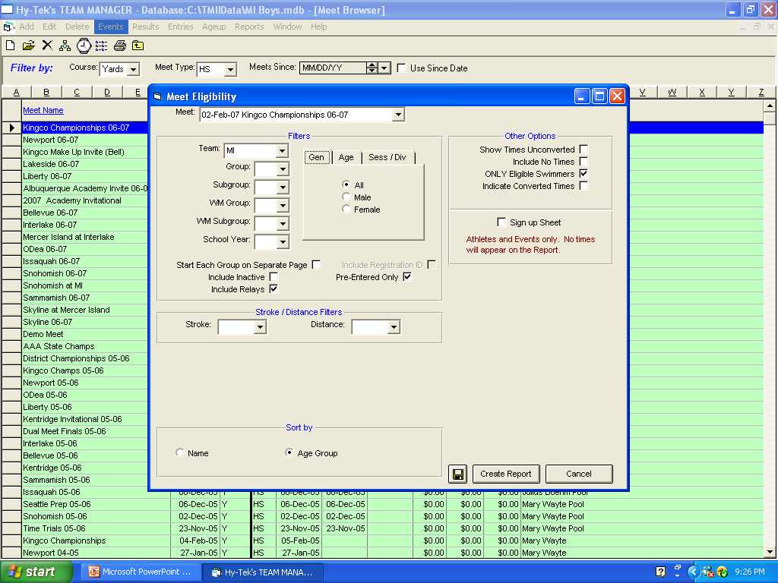
Meet Eligibility Report –
Select the group/ sex / age you want.
(check Indicate converted times if you have any results from a meter pool)
Pre-entered and include relays

Slide 40
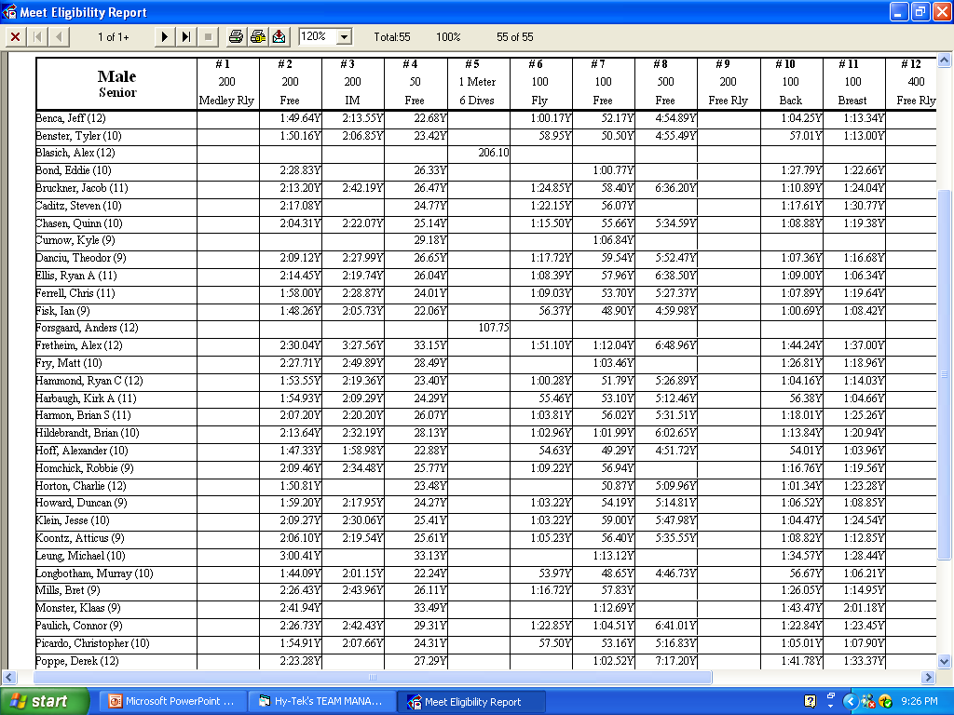

Slide 41
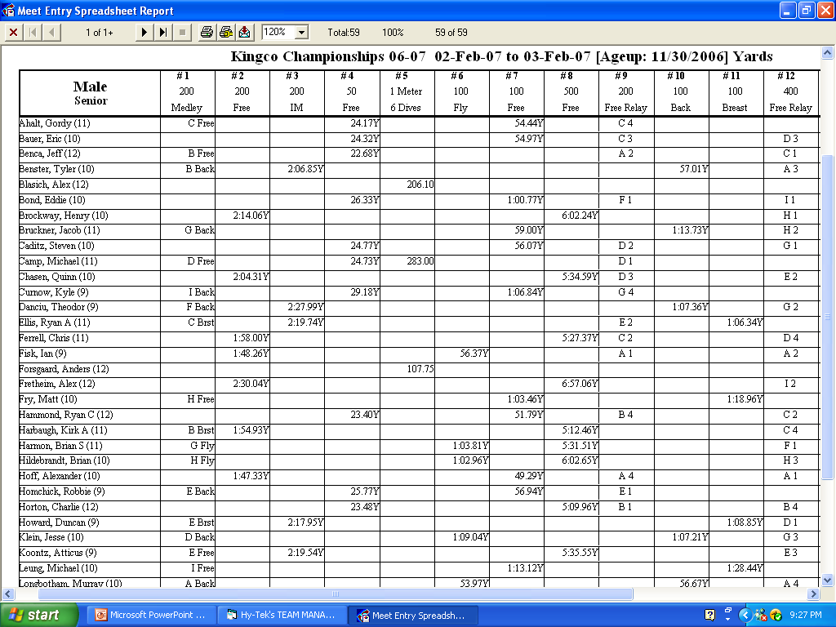

Slide 42
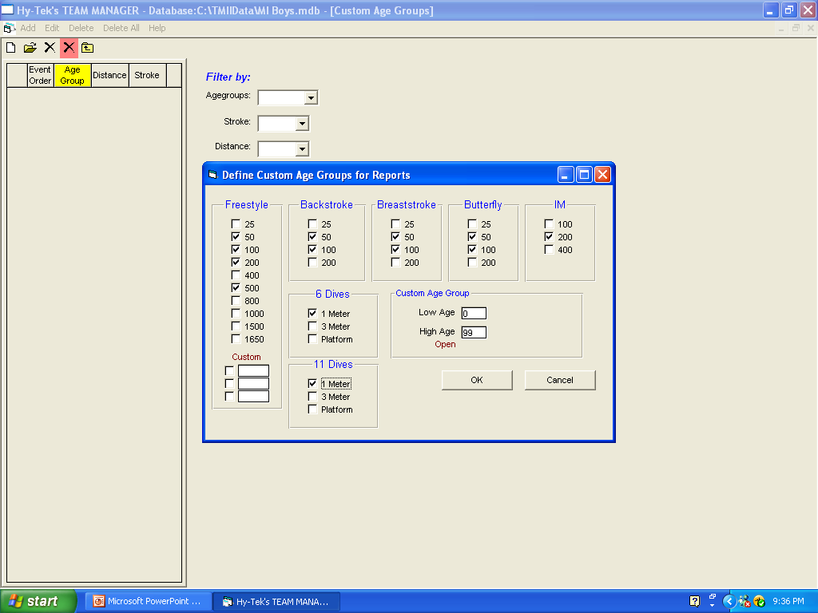
Before using the top times spreadsheet – set custom age groups for your team.
Go to Set Up/Preferences/Set Custom Age Groups

Slide 43
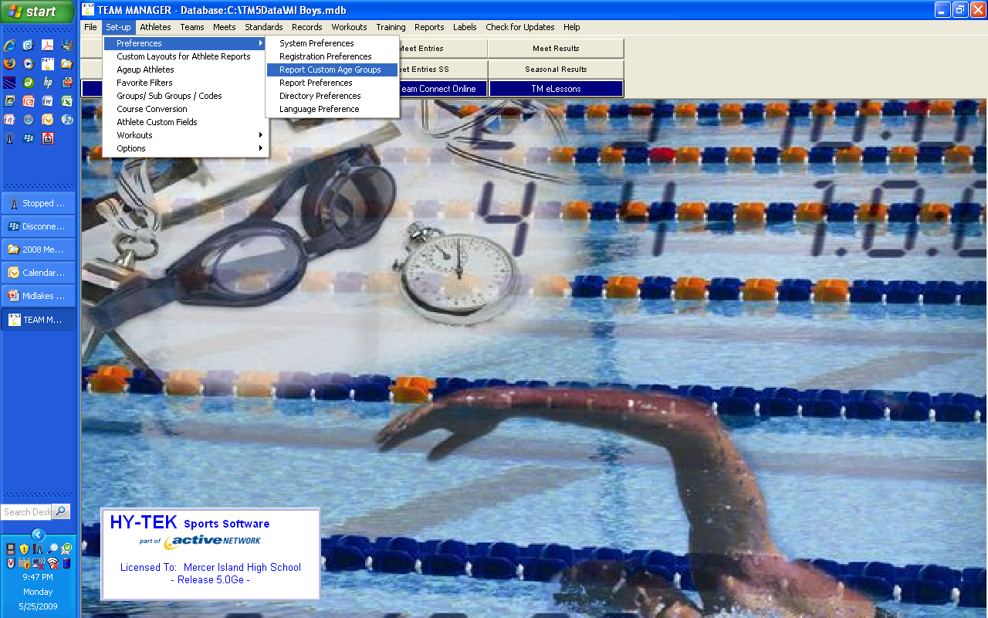

Slide 44
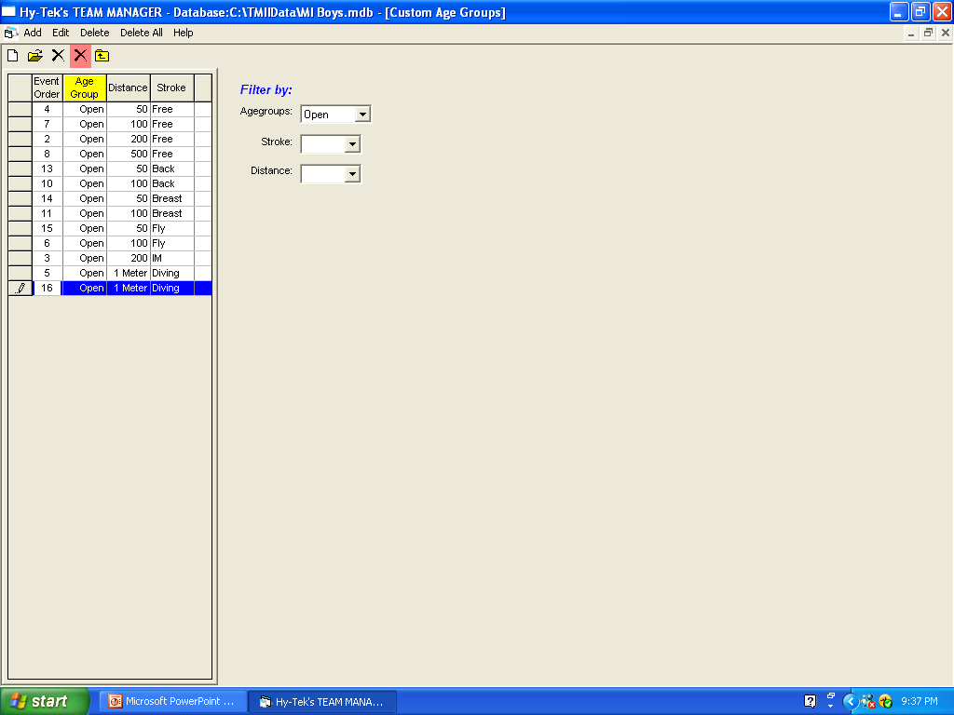
After setting up the age groups – set the order of events for the age group. The report will reflect the order that is set in this screen.

Slide 45
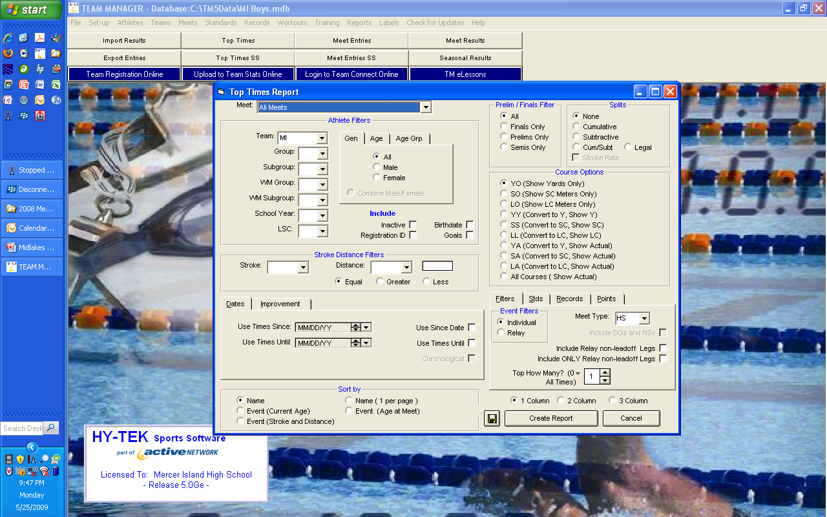

Slide 46
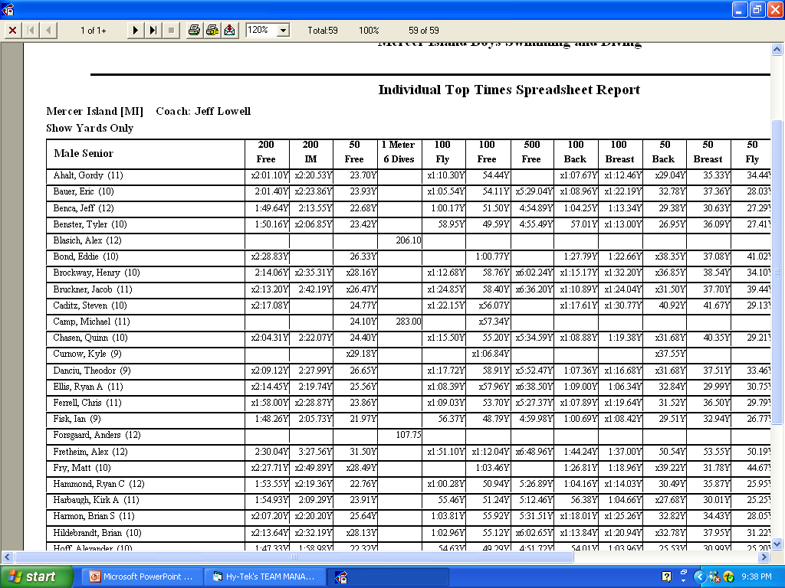

Slide 47
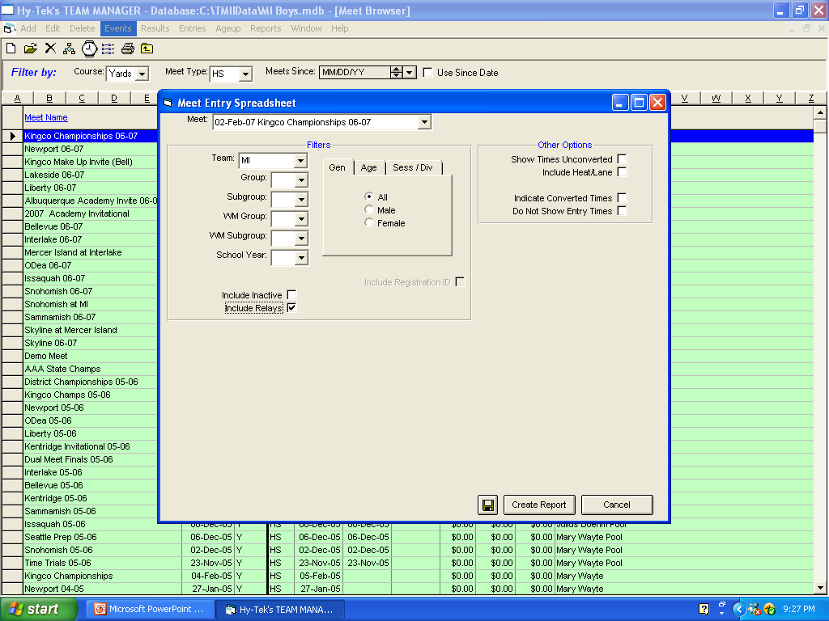
Meet entry spreadsheet allows a coach to print entries by age group in a format that allow for review – catching oversights before a meet.

Slide 48
Meet results can be entered quickly without ever having to enter the swimmer's name.
Just select the event and TEAM MANAGER will display all eligible swimmers for that event.
Pick one using your mouse or keyboard and enter his/her swim time (optionally enter splits, stroke rate, place and points).
  Or select a swimmer's name from an alphabetical list and TM will display all of his/her eligible events from which to choose.

Slide 49

Be sure to check for updates occasionally in order to keep your software fitted with the most current version of TM.

Slide 50
E-Lessons can be found at www.hy-tekltd.com
TEAM MANAGER 6.0 is scheduled for Beta Release June 1 and for production release July 15, 2010. TM 6.0 is the most advanced and exciting product we have ever released and is packed with over 75 NEW features including TEAM MANAGER's new web based products that make managing a swim team easier and faster, with less work!

