Slide 1
Midlakes Hy-Tek Clinic 2010
Jeff Lowell, Assistant Principal, Interlake High School
  Past Coaching Experience:
    Mercer Island HS
    Mercerwood Shore Club
  Past President, WISCA
  Zone 8 Rep, NISCA
  Over 16years experience with HyTek programs
  7 years as instructor for Midlakes
Contact Information
  C: 425-495-5318 E: jefflowell@speakeasy.net

Slide 2
Midlakes Hy-Tek Clinic 2010
Eric Bartleson, General Manager, NHSTC
  Coaching Experience:
    Newport HS
    Newport Hills Swim and Tennis Club
  Treasurer, WISCA
  Over 16years experience with HyTek programs
  7 years as instructor for Midlakes
Contact Information
  Work: 425-746-9510
  Eric@nhstc.com

Slide 3
Introduction: This workshop is geared for summer league coaches/volunteers that may not be familiar with TEAM MANAGER. Please ask lots of questions and we will do our best to help.
Some information for this presentation copied from http://www.hy-tekltd.com/

Slide 4
Workshop Plan
  Timeline:
6:00 - 6:45 pm Team Mgr Training
6:45 – 7:30 pm Meet Mgr Training
7:30 – 9:00 pm Open Session

Slide 5
I. Information and materials you will receive today
  Sample Dual Meet, “B” Disqualification Times, Midlakes Records. If you cannot load these onto your computer, I will email this information to you.
II. Software Update
  Periodic updates are available on the web at (www.hv-tekltd.com). Program should be updated to the latest version possible. Currently MM 2.0 Fu Meet Manager has an easy way to update if you are on the internet by just selecting the “check of updates” button
III. A couple of items to remember
  File/Repair Database - If you are experiencing data problems try this.
  Please be sure to backup your database while running a meet. Also try exiting the program, turning off the computer and starting fresh.

Slide 6
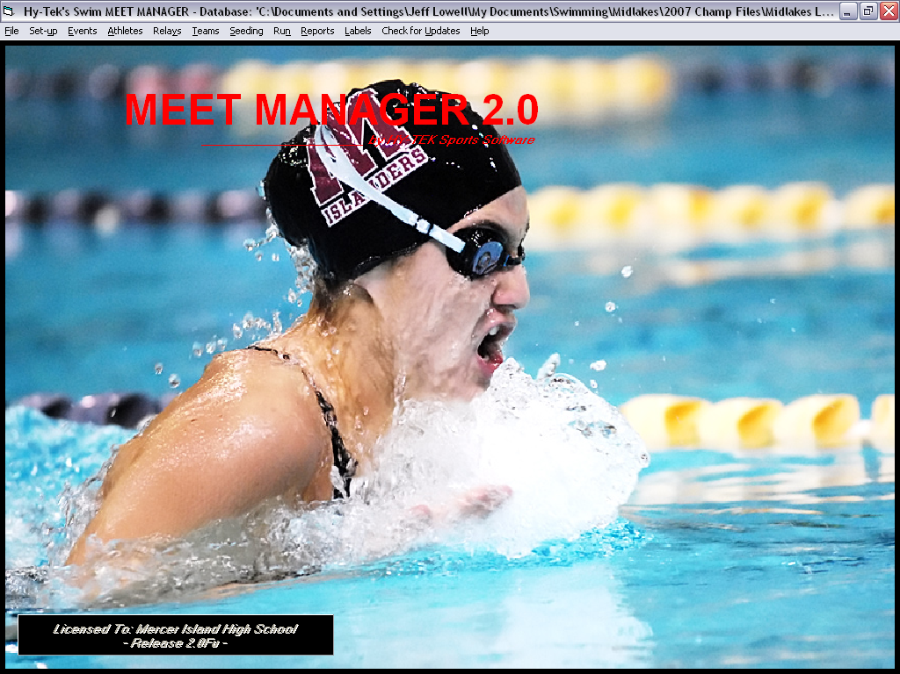

Slide 7
2010 Hy-Tek Meet Manager 3.0
Creating a New Meet –
Other items for meet day
Running a division champs
Elessons on Hy-Tek website
Updating program

Slide 8
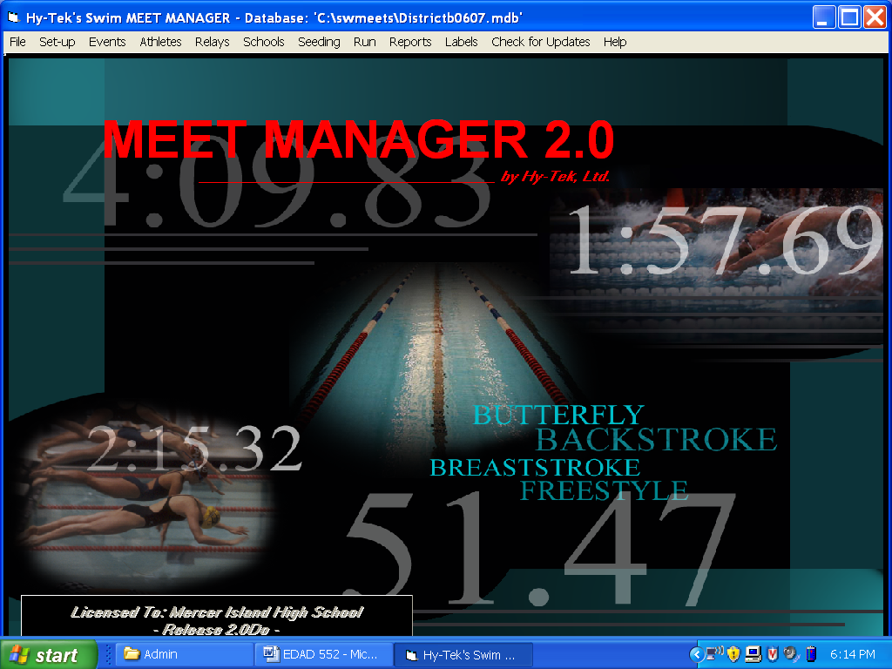
The above menu will be discussed throughout the class
The Set Up menu is the key before the first meet
Check for updates – this option allows to connect with the HyTek site for current updates
  Must be connected to the internet
  Save the update file and then use the install updates option from the FILE Menu

Slide 9
Create a New Meet
Import Sample Dual Meet
File/New - Create a new meet. Give a name and starting and ending dates. Additional data is not necessary, as the sample meet will give scoring info, events, time standards, etc.
File/Save as - easy way to create a new meet from last weeks meet. Just rename the meet and purge/remove data selectively then make changes to the Meet Setup.
File/Restore - Put Backup disk in drive a:. or from local drive. Restore data from backup.

Slide 10
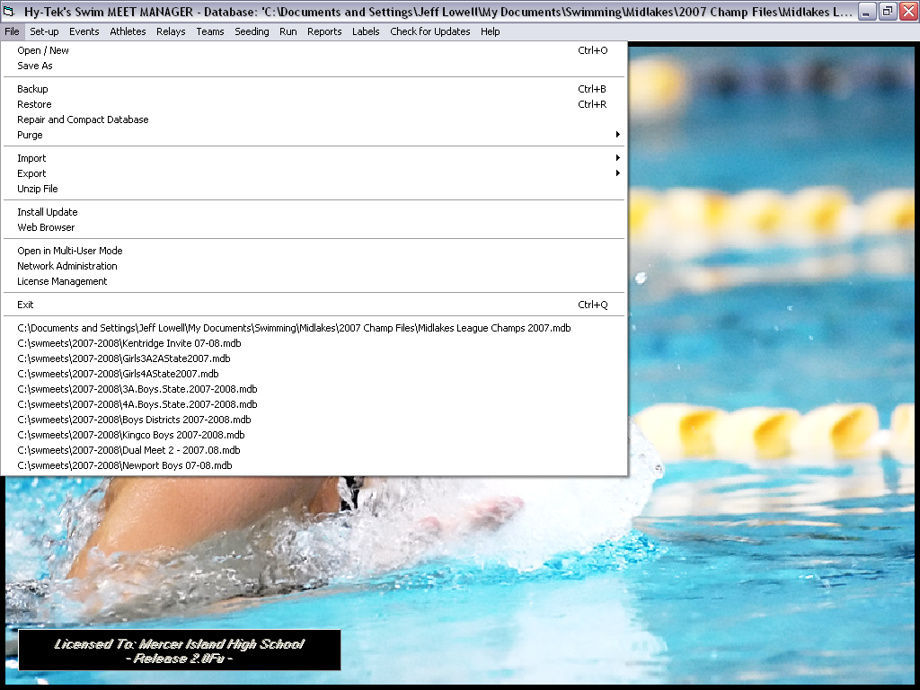

Slide 11
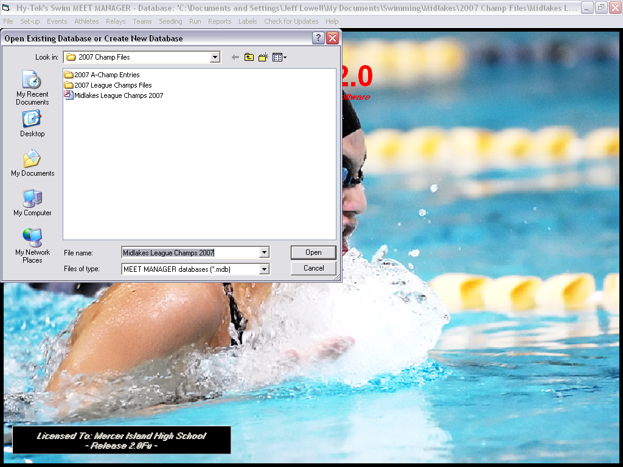

Slide 12
  File/Purge/Remove Data Selectively –
  Selective Purge.
    Check Teams, Athletes Entries/Results, Relays.
    Leave all other boxes unchecked.
      This is important if you are not saving each meet, or setting up a new meet each week.
      It does not take long to set up a new meet each week in order to ensure the database has protection in case of error later.

Slide 13
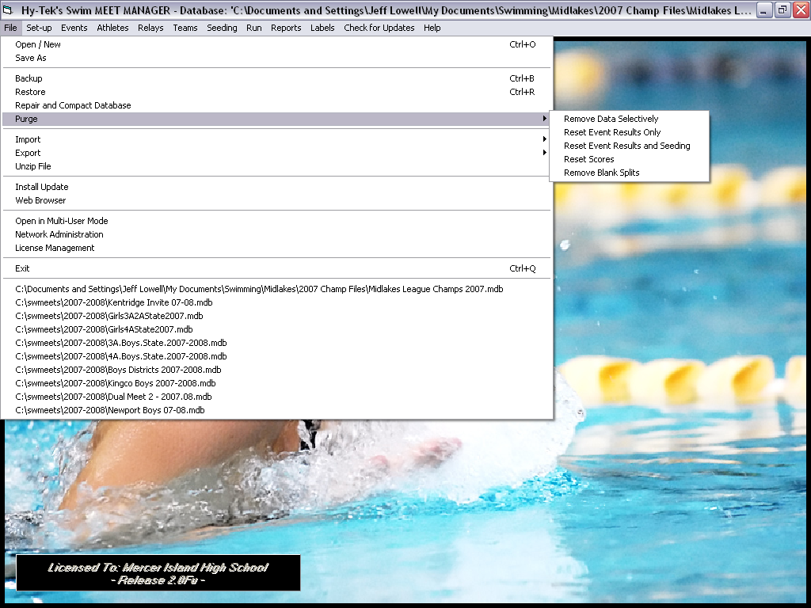

Slide 14
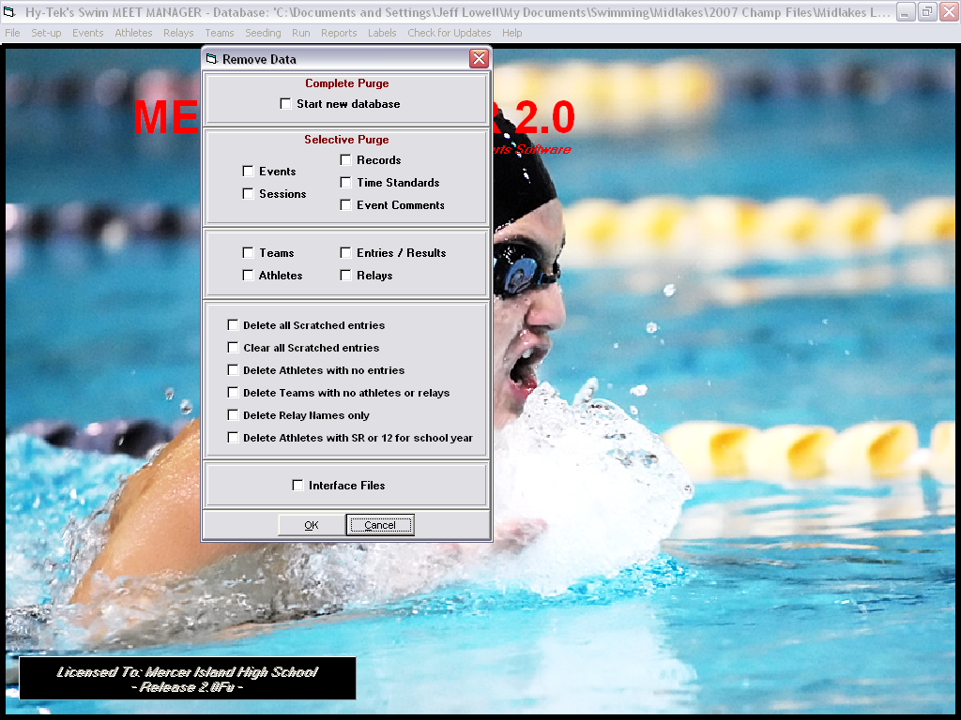

Slide 15
II. Set-up
  Set-up/Meet Set-up –
    Fill in the name (i.e. Team A vs. Team B) location and start date of the meet.
    Example: SS @ KGR A-Meet 6-15-07
      Remember to change to short course meters if the pool you will be swimming in is meters, as the sample is in yards.
      Sample indicates 6 lanes, but change to appropriate number to reflect the pool in which you will be swimming current meet (Either 4, 8, or 5).
  Set-up/Athlete/Relay Preference –
    Check - Enter Ages, Enter Birth Dates, Date for computing ages (06/15/2009), Warn if Times are out of Range.

Slide 16
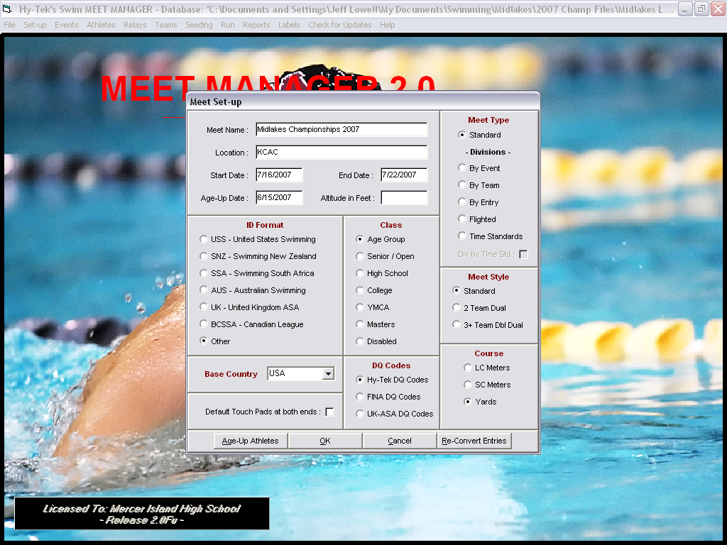

Slide 17
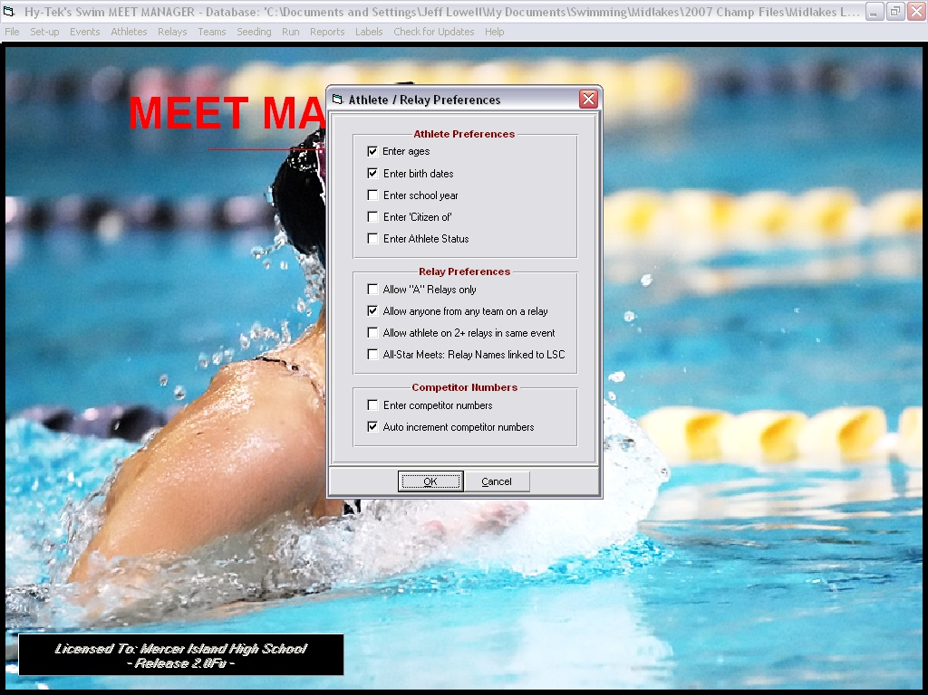

Slide 18
  Teams/Add Teams –
    You will not need to do this if you import the two teams’ meet entries first as this information will be included with the entries
    Fill in team names and abbreviations of the two teams involved in the dual meet.
    Delete unattached team.
    If you input a team name that does not match the one when you import the entries you will add a team to the meet and not overwrite the name already in the data base.
    If this happens, delete the name that you put in and not the one from the import. If you are unsure, just delete both and re-import the entries.

Slide 19
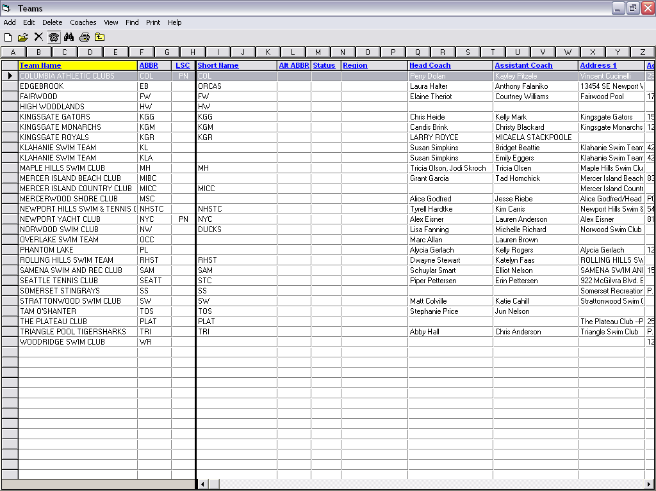

Slide 20
  Set-up/Seeding Preferences –
  Do this setup after you have imported the two teams entries.
    Go to dual meets and place teams into lanes.
    Check boxes: strict assignment all heats and use lane assignments above.
    You can go back and manually change the seeding from the seeding/preview event
    Note: Home - ODD - Away EVEN for scoring heat.
      For exhibition heats teams can choose to combine teams like the scoring heat or single team for each heat. Coaches must communicate with each other on what they want.

Slide 21
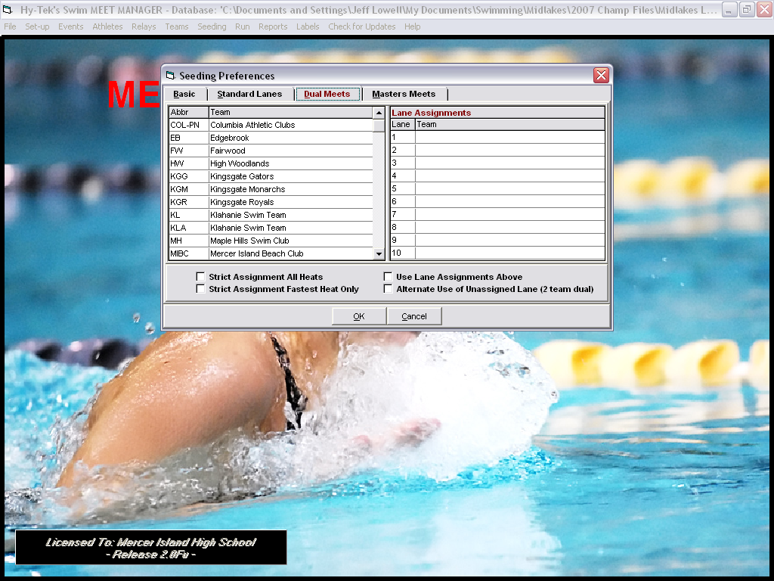

Slide 22
  Set-up/Set-up/Report Preferences
    List printers used, number of copies desired
  Set-up/Entry/Scoring Preferences - Set number of award labels desired.
      Maximum scorers for relays and individuals - 2
      Maximum entries per athlete including relays - 4
      Maximum individual entries per athlete - 3
      Maximum relay entries per athlete - 2
  Set-up/Scoring Set-up
    Individual Points
      5,3,1
    Relay Points
      8,4,2

Slide 23
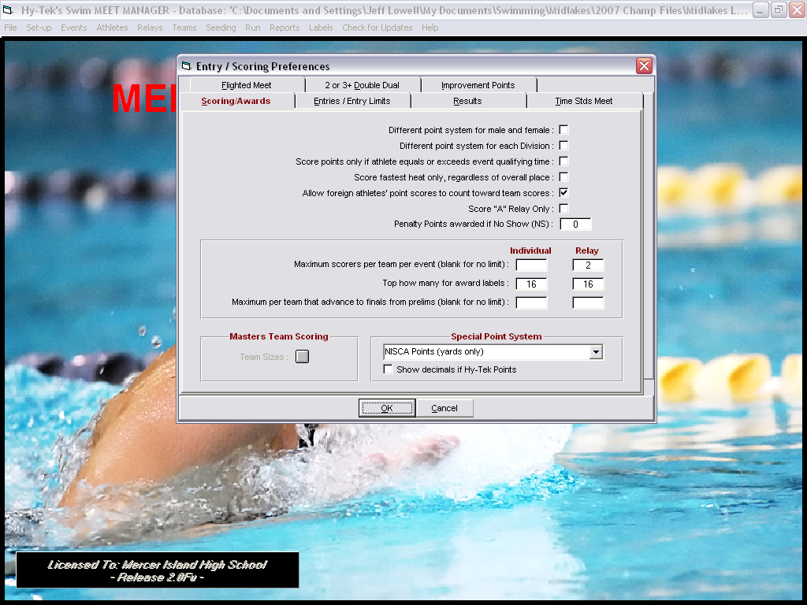

Slide 24
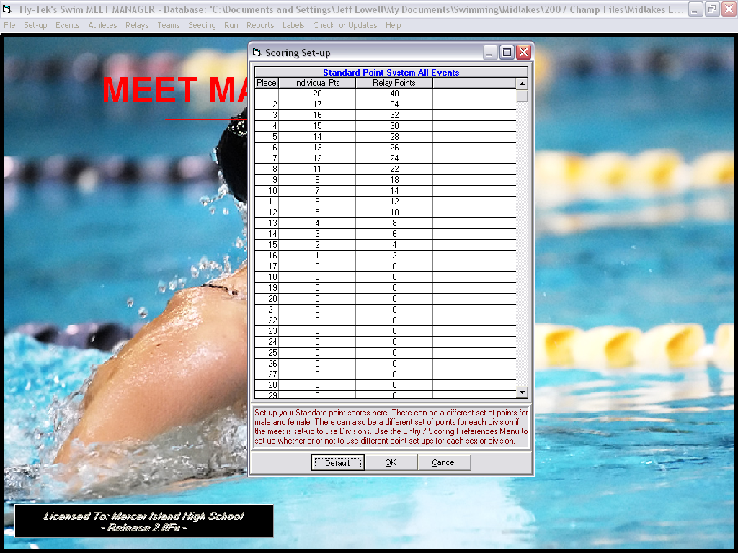

Slide 25
III. Set up Events, Records and Time STDs
Events/Records –
  Enter Midlakes and/or team records here.
  The Midlakes records are already in the Sample meet.
  If you want to add team records, or meet records, you must ADD TAG and fill in the information for each event.
  The information can also be imported from a TM file.
  ONCE THIS INFORMATION IS IN YOUR MEET, IT WILL COME THROUGH WITH EACH MEET.
  We can try this tonight if you would like….

Slide 26
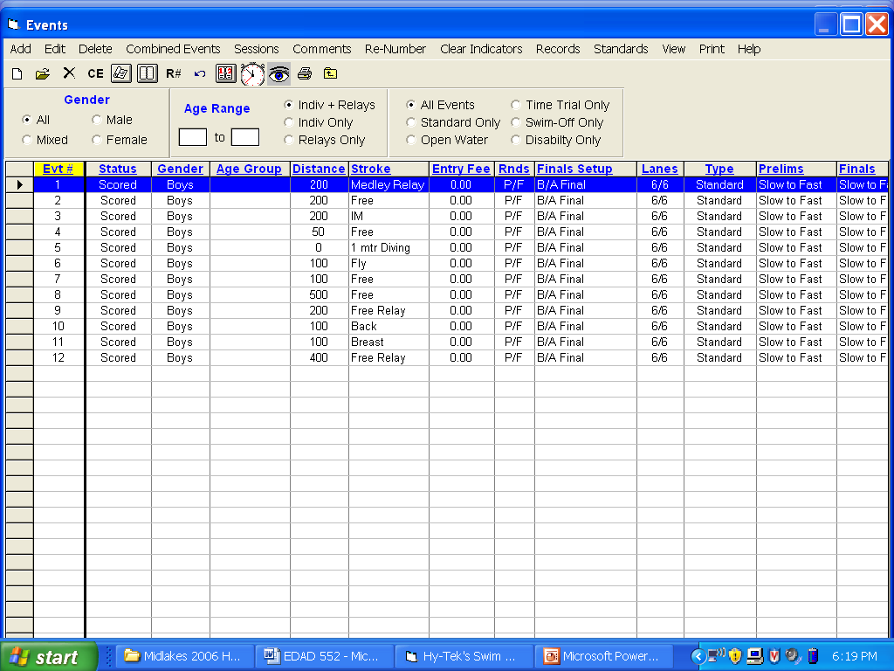
The add function is where an operator can alter the event order of the meet
The records menu is where team/Midlakes records are modified
The standards menu is where B DQ times are modified
Be sure for a dual meet each event is set up a F (final) only
Be sure the events are set up for the number of lanes in your pool.

Slide 27
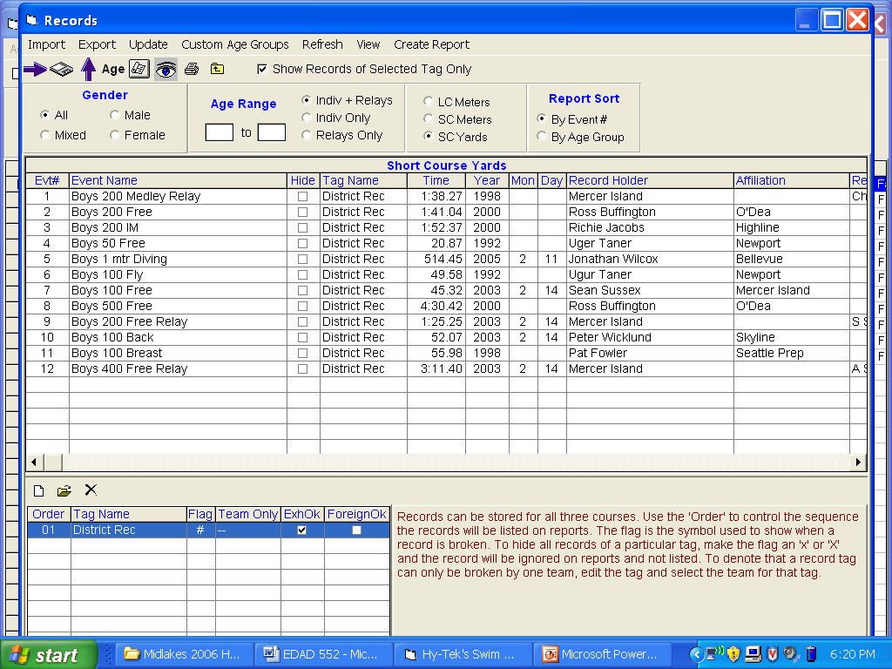
The update feature allows an operator to update record tags after a meet as the computer checks results against stored records
Records can be stored for multiple courses
This menu allows for the addition and deletion of record lists (review the information in the paragraph below as well)

Slide 28
  Events/Time Standards –
  2009 Midlakes short course yard and meter time standards.
  If you need to replace standards
    transfer the individual event time STDs by disk (received tonight)
    You can also export/import these standards between Meet Manager and Team Manager
    Events/Time Standards/Import or export­

Slide 29
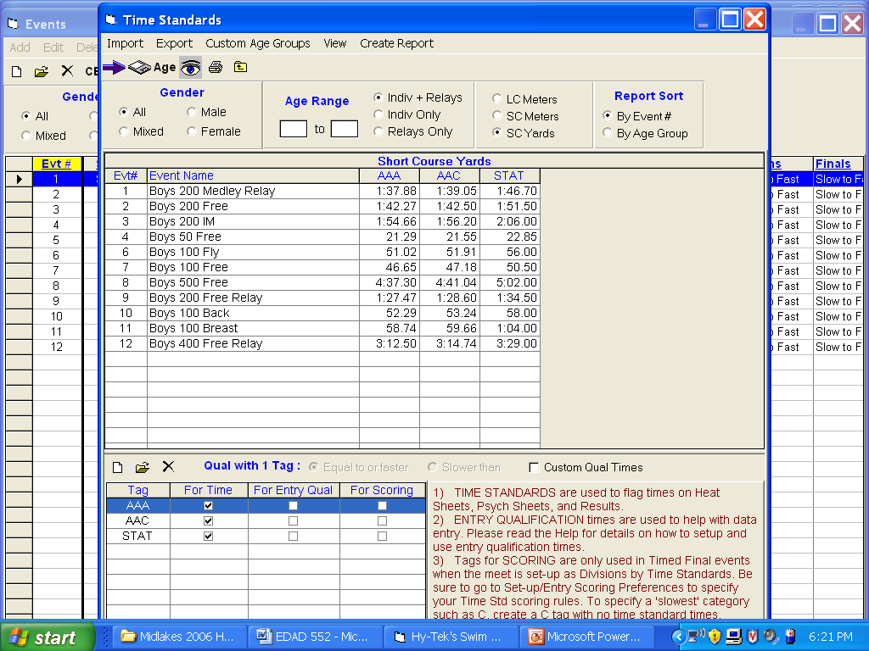
Time standards can be exported and more importantly imported. B DQ times are provided for you tonight to import into your machine
Again – the standards can be saved for multiple courses
Multiple standards can be stored
Standards are listed on reports as printed

Slide 30
VI. Meet Entries
Meet entries should be filled out in Team Manager 5.0
  Export entries file and athletes file.
  These files will then be imported into Meet Manager.
LEAGUE POLICY:
  Information should be sent no later than the day of the meet from the visiting team by 1pm.
  This allows the home team to produce paperwork for BOTH teams prior to warm up.

Slide 31
VI. Meet Entries
The Team Manager program allows you to assign heat and lane information for the swimmers entered in a meet.
If Heat and Lane have been included by both clubs you will not need to seed the meet as it will be seeded automatically.
This is perhaps the easiest way for coaches to ensure athletes are placed in the lanes in which they would like them to swim.
Team athletes file needed to replace a swimmer who was not initially in the meet because of a no show
  You must be able to prove that the swimmer is part of your team
  If the swimmer is not in your Athlete roster export, they will not be eligible to swim. This rule has to do with the league’s insurance.

Slide 32
  Import Home and Away Team's Entries and athletes
    File/Import/Entries – select file from appropriate drive. Select match on event number and include entries with no times
    File/Import/Rosters only – select file from appropriate drive
  Seed Home and Away team’s entries
    Seeding/Select All/Start Seeding: you will not need to seed the meet if the entries you have imported from Team Manager include correct heat and lane information from both teams. This can be checked by selecting the run meet option and checking for names in events. If this is blank then you will need to seed the meet and let the coaches know that any lanes and heats assigned in team manager are not correct.

Slide 33
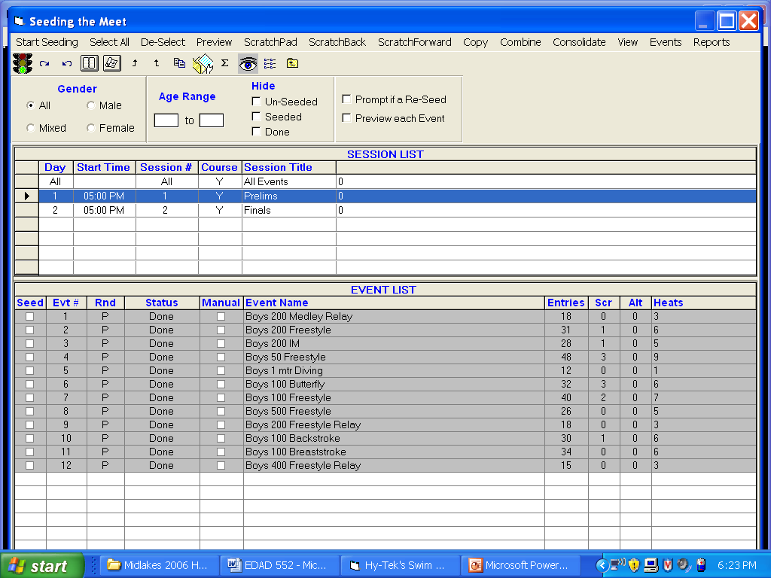
Choose Select All to choose events to seed
Preview selection allows for individual events to be edited/changed
Entries etc. allow for quick view of what an event looks like for a meet.

Slide 34
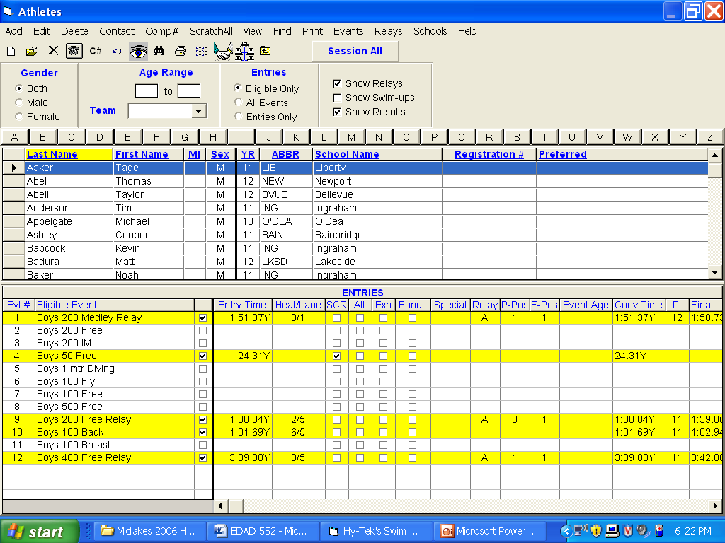
The add, edit, delete functions allow for the manipulation of athlete lists
The SHOW options allow an operator to see ALL events an athletes may be eligible
The menu below allows an operator to see if an athlete’s information is complete – including HEAT and LANE, and you can select to scratch an athlete right here
Relay information from a swimmer can be seen and edited here

Slide 35
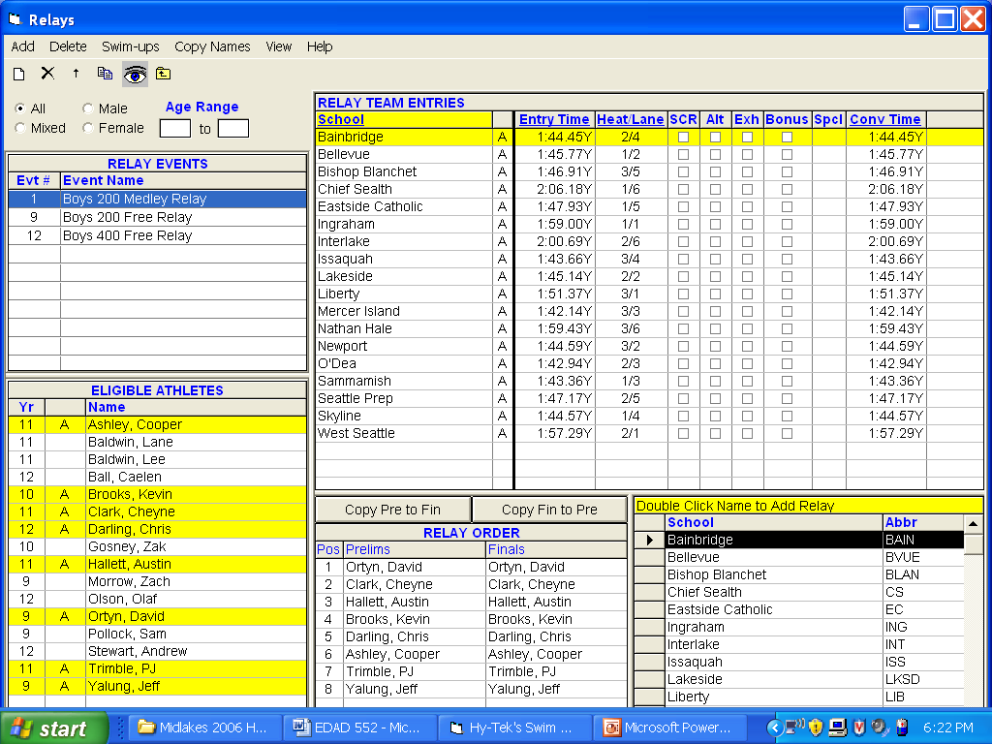
Function allows for global name changes to relays
Listed for selected school only

Slide 36
V. What to do prior to the meet.
Pre-Meet Paperwork to do after you have both teams seeded for the meet.
  Meet Program or Heat Sheet
    Reports/Meet Program/Select All-
      This will produce a heat sheet for coaches, officials and to post.
      Check these boxes before producing the report:
        Triple Column, Time Standards, Entry Times, and set Relay Athlete Names to 4.
        Have coaches check for any corrections ie. a swimmer needs to be added or removed from the meet.

Slide 37
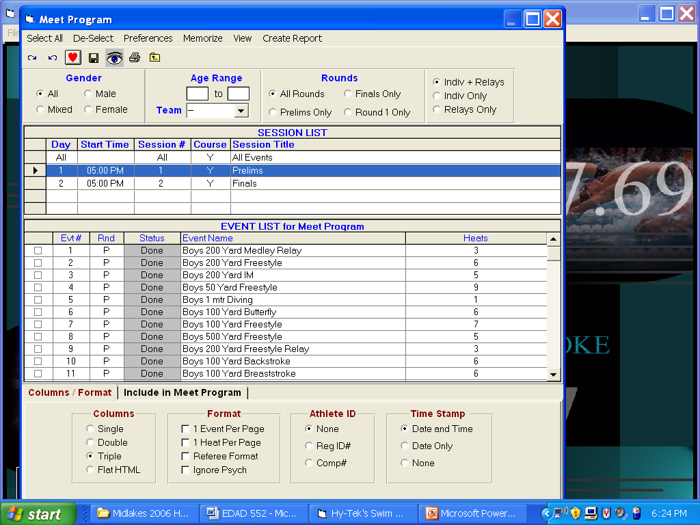
Found in reports
Used to create a heat sheet
Choose select all then create report
Format allows for different looks
The HTML function helps with website results or emailed reports for media, etc.

Slide 38
  Timer Sheets
    Report/Lane/timer sheets –
    Select All or highlight events desired. (make sure you have checked the box to show Individual and relay events)
    Format check continuous or one or two events per page
      (note this is up to the host team and the amount of paper you want to use as you can set it to one or two events per page or use the continuous and set the # of events break for continuous to any number that you want.)
    Check include entry times, Double space and set relay swimmer names to four.
    This will allow timers to check off who swam and if the order changed.
    Set the lane range for the number of lanes that you have at your pool. (note you can reprint just one lane if you need to make corrections to that lane)
      Set sort by to Lane then event so that all of the sheets for one lane will print in order.

Slide 39
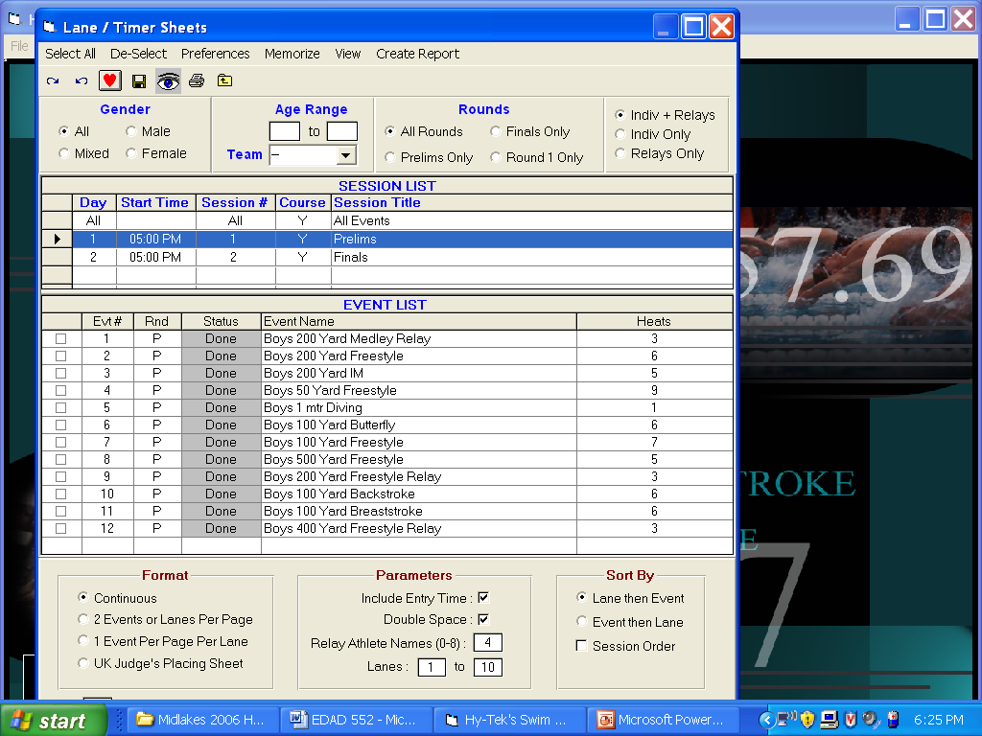
In the reports section – used to print timer sheets. These replace cards for a team. Should be combined for both teams in a dual meet.
Choose Select All and then Create Report
Format is important!
The best option for your computer workers is 2 events or lanes per page.
This allows for a half page to be sorted by lane and a steady stream of results to come to the computer worker.

Slide 40
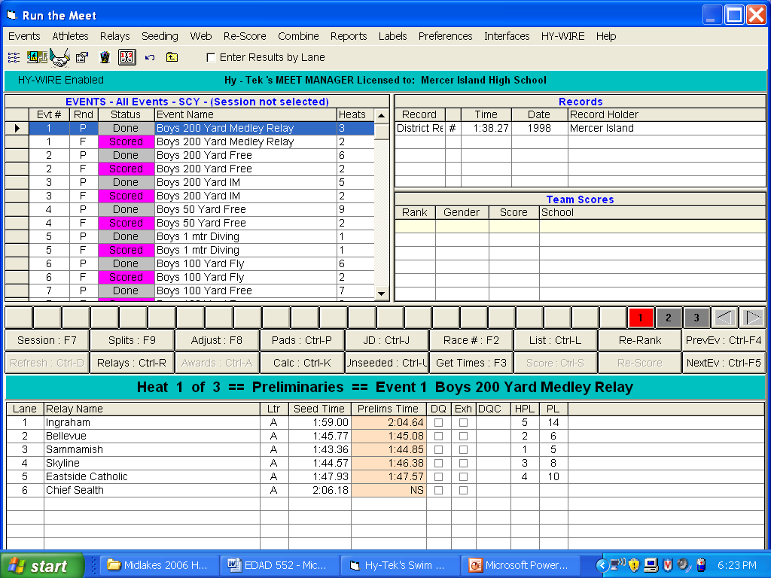
USEFUL TOOL WHEN ENTERING TIMES WITH TIMER SHEETS
This is the option that allows for an operator to manipulate athletes / heats during the meet
USED AT THE END OF A RACE TO FIND RESULTS
USED TO CALCULATE AVERAGE TIMES

Slide 41
VI. Run the Meet
  Run/Preferences/run screen- Select to show backup times column and show DQ codes column.
    Enter Times by heat or Lane: Normally this would be set by Heat but if you have multiple heats of one event, you can switch to by Lane and enter all the times from one lane from the timer sheets.
  Enter Times: Select the event that you need to enter times.
    You have two options for entering times.
      If you have three times, the time entered is the middle time or the two times that are the same.
      If you have two times, you must average the time and drop the remainder 23.17 and 23.14 averages to .155 you would enter 23.15 not 23.16.
      If you have the backup time column showing (run/preferences/backup columns) you can enter both times under the Backup time 1 and Backup time 2 columns and have the computer average the time for you. (PREFERRED METHOD)

Slide 42
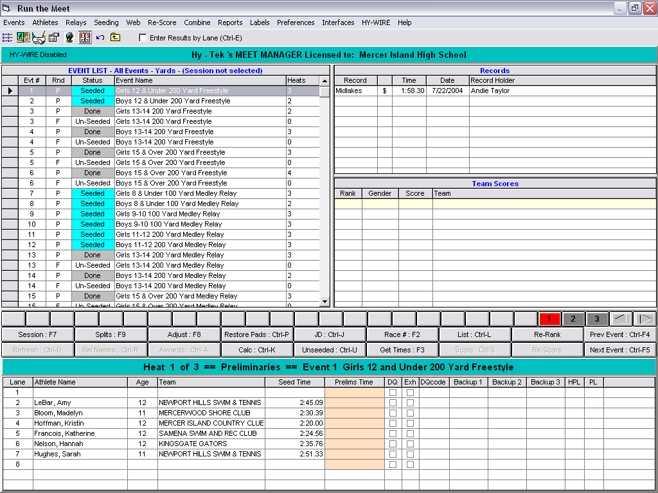

Slide 43
Adjust/Show Eligible Athletes:
  If you need to scratch a swimmer, double click on their name.
  To substitute a swimmer - - Highlight the swimmer and drag to the open lane or to the swimmer that you are replacing.
  Then click on Accept.
  If the swimmer is not already in the meet you will need to add her.
    Note ( you should have received the away team entire team roster (A and B) and imported the roster into meet manager. Swimmers that are not on this roster should not swim in the meet. So this addition should only happen if you did not import the roster.
(Athlete Menu/Add Athlete - After Athlete is added use above directions to insert into empty lane.)
  If there is more than one heat, click on the next heat number. Be sure each individual or relay exhibition swims are marked accordingly.
  After the names and times are checked against the cards - Score Event.
  Then proceed to Next Event, unless you are printing award labels. Then proceed as directed below. Results of event will show on screen. If you wish to print, click on printer icon.

Slide 44
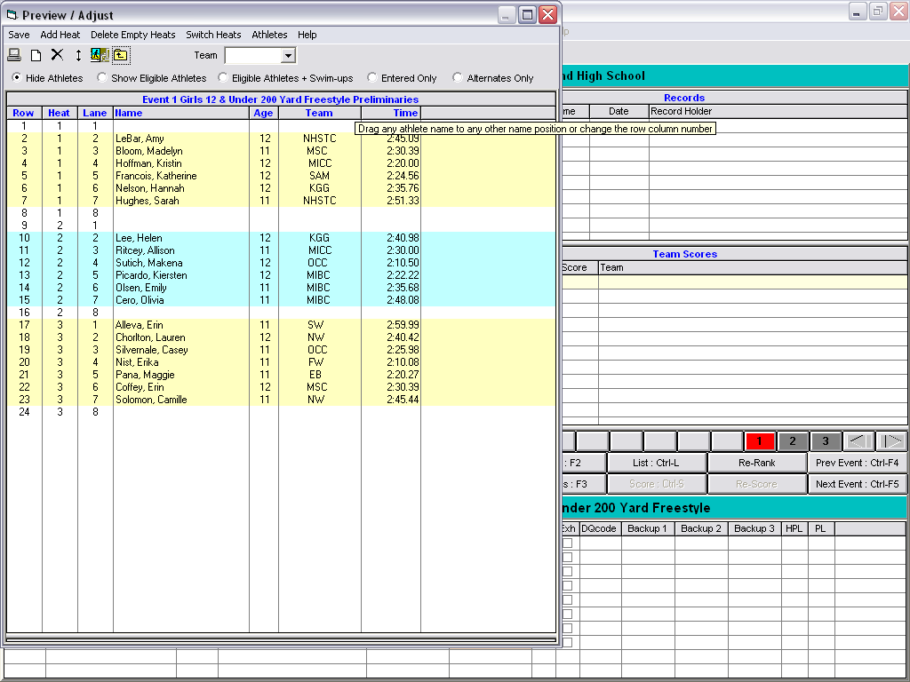

Slide 45
  DQ Codes -
  These are a useful way to help coaches and swimmer know why someone was DQ during the meet.
  To print up the list of codes go to Reports/Administration select DQ code list and create the report.
  Only the DQ codes that are applicable to the event will come up when you select the pull down list in the DQ codes column.

Slide 46
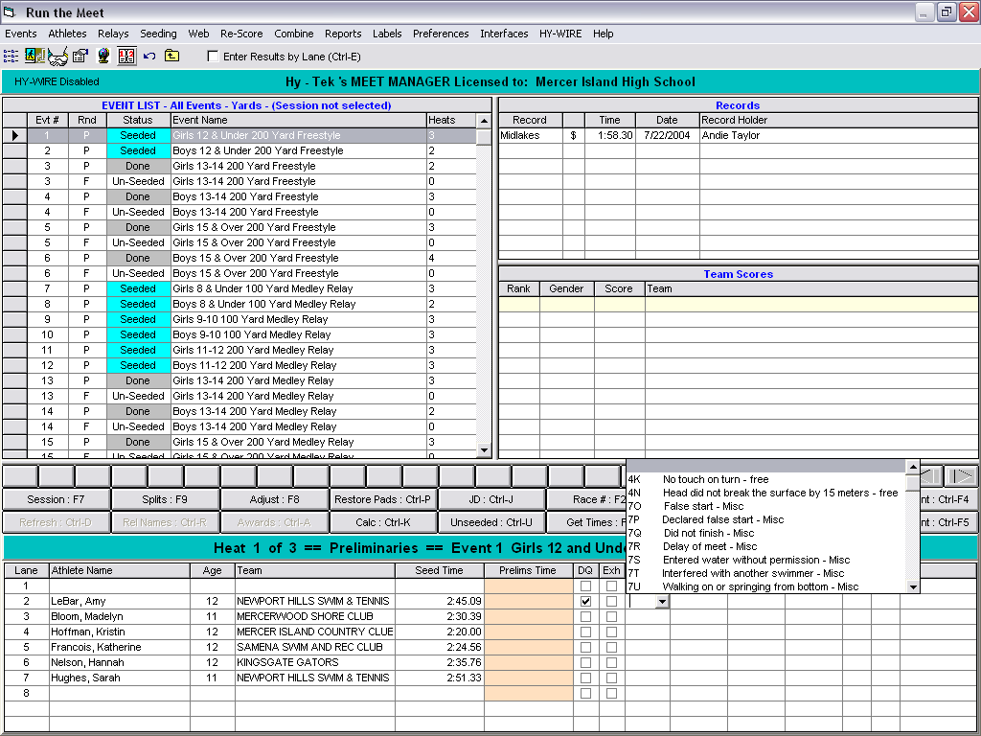

Slide 47
Newport Hills Swim/Tennis Club Hy-Tek's MEET MANAGER 5/29/2006 Page 1 Sample Meet - 5/31/2006
DQ Codes List Butterfly
1A Alternating Kick
1B Kick breaststroke type
1C Scissors kick
1E Non-simultaneous arms
1F Arms underwater recovery
1J One hand touch
1K No touch
1L Non-simultaneous touch
1M Shoulders not at or past vertical towards breast off the wall
1N Head did not break the surface by 15 meters
Backstroke
2I No touch at turn
2J Non-continuous turning action
2K Not on back off wall
2L Shoulders past vertical toward breast
2N Head did not break the surface by 15 meters
2P Toes curled over gutter after the start
Breaststroke
3A Alternating Kick
3B Non-simultaneous kick
3C Downward butterfly kick
3D Scissors kick
3E Hands brought beyond the hipline during stroke
3F Non-simultaneous arms
3G Arms two strokes underwater
3H Arms not in same horizontal plane
3I Elbows recovered over water
3J One hand touch
3K No touch
3L Non-simultaneous touch
3M Shoulders not at or past vertical towards breast off the wall
3P Head under for 2 or more strokes
3Q Incomplete stroke cycle other than one pull followed by one kick
Freestyle

Slide 48
4K No touch on turn
4N Head did not break the surface by 15 meters
IM
5P Strokes out of sequence
Relay
61 Stroke Infraction swimmer #1
62 Stroke Infraction swimmer #2
63 Stroke Infraction swimmer #3
64 Stroke Infraction swimmer #4
66 Early take-off swimmer #2
67 Early take-off swimmer #3
68 Early take-off swimmer #4
6P Changed order of swimmers
6Q Not enough swimmers
Miscellaneous
7O False start
7P Declared false start
7Q Did not finish
7R Delay of meet
7S Entered water without permission
7T Interfered with another swimmer
7U Walking on or springing from bottom
7V Standing on bottom
7W Pulling on lane line
7X Finish in wrong lane
7Y Unsportsmanlike conduct

Slide 49
VII. Print Award Labels
  Run/Labels/Award Labels - Make selections as needed. Use standard award Label. - After each event is scored, labels may be printed. If you are using the continuous tractor feed labels on a dot matrix (second) printer this makes sense. If you are using a laser printer for reports and labels you may want to print when you have enough labels to fill a whole sheet.
VIII. Score Meet
  Make sure you have done the Setup/scoring setup/standard and entered in 5,3,1 for Individuals and 8,4,2 for Relays. You must also go to setup/entry/scoring preferences and set the maximum scorers per team to 2 for Individuals and Relays. The program will score as you go by selecting score after entering all times – make sure exhibition swimmers have been checked so that they will not be eligible to be scored. If you need to make a correction in an event that has been scored, just make the correction and select Re-Score.

Slide 50
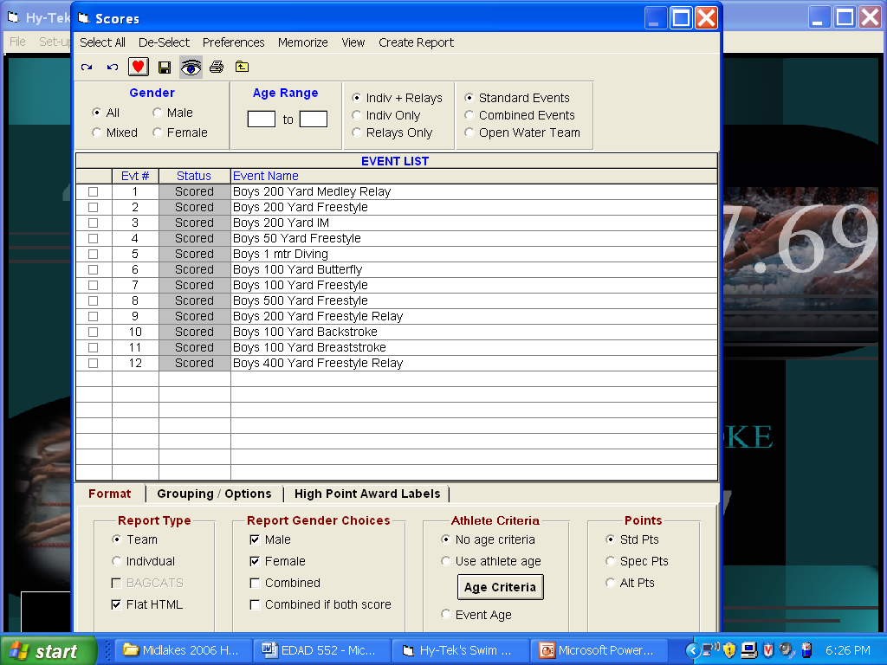
To create a scores report – SELECT ALL
Be sure that Individual and Relay events are selected
Be sure to select the TEAM option – HTML if you are emailing the report
Be sure to select the COMBINED option so that the scores are not broken out by gender
Then choose CREATE report and print

Slide 51
IX. Print Results
  Reports/Results/Select All/Create Report - At the conclusion of the meet, print the results for distribution to teams. For Printed Report use these selections: Columns - Triple, Splits - None, Relay names 4, include in results: Time standards, Entry time, DQ Codes, Athlete/relay points, Combined score
  Report for Website: To create the report for the midlakes website. Instead of selection columns – triple select THE PDF OPTION and follow the provided instructions.

Slide 52
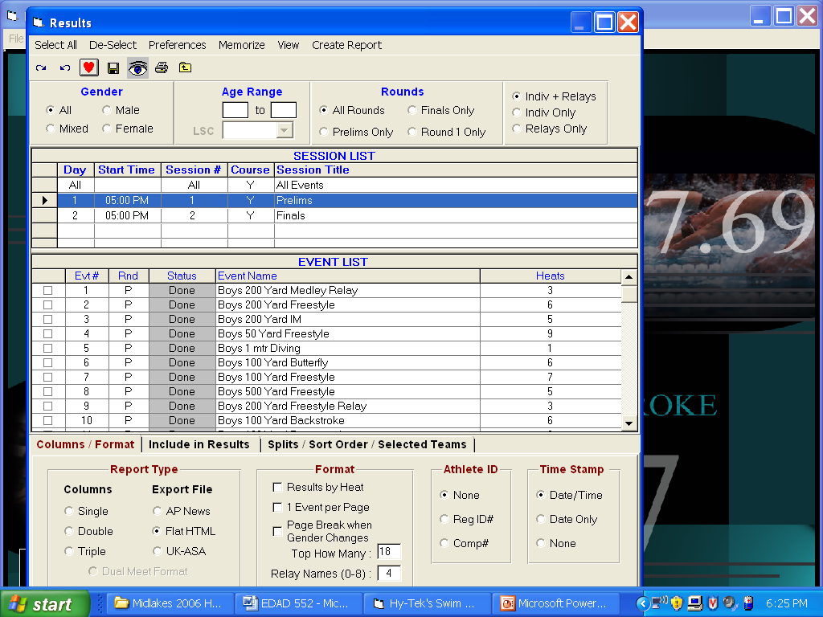
In the results menu
Choose Select All then create report
It is important to look at Report Type and Format when printing results.
Again the flat HTML choice will allow for email
Leaving Top How Many blank and relay names blank will print all names in the meet.

Slide 53
X. Back-up Results to Disk for Visiting Team's
  File/Back-up: The away team should bring a disk for you to place a backup of the meet. Do not give an export of results, they can create this file on there own computer after they restore the backup to their computer.
  File/Export/Results – This is the file you must create to import the meet results into Team Manager. Select the team you wish to export results, include relays.
You are now ready to run a great Midlakes Dual Meet!

Slide 54
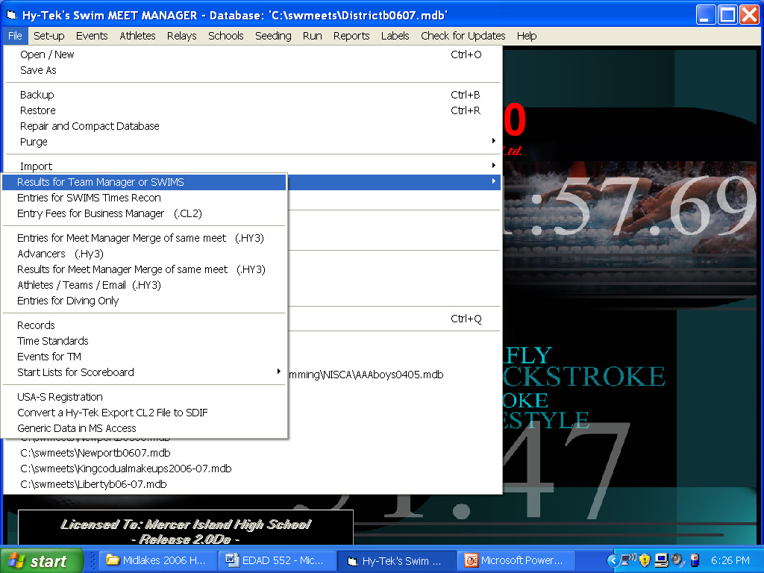
Under the FILE heading – this is the selection to choose to EXPORT results
Choose EXPORT
Go to RESULTS for TM or SWIMS
Follow directions
  Be sure to remember where the file is saved
  This is the file to send home with opposition coaches

Slide 55
Other Items
Entering Splits for relays - This can be done in the run menu select splits. Enter splits cumulatively. By doing this prior to exporting results to team manager, you will be able to track split times in team manager when running reports and creating best relay reports from Team Manager. You can also include splits on meet result reports for you team.
If you have a timing console/touch pads, you will want to order the Timing Console INTERFACE option.
  The Timing Console INTERFACE option is software built into MEET MANAGER which allows MEET MANAGER to connect directly to popular timing consoles

Slide 56
“B” DQ report
Midlakes Championship Meet
Hard copy of Instructions

Slide 57
E-Lessons can be found at www.hy-tekltd.com
TEAM MANAGER 6.0 is scheduled for Beta Release June 1 and for production release July 15, 2010. TM 6.0 is the most advanced and exciting product we have ever released and is packed with over 75 NEW features including TEAM MANAGER's new web based products that make managing a swim team easier and faster, with less work!

Slide 58
Extra Slides

Slide 59
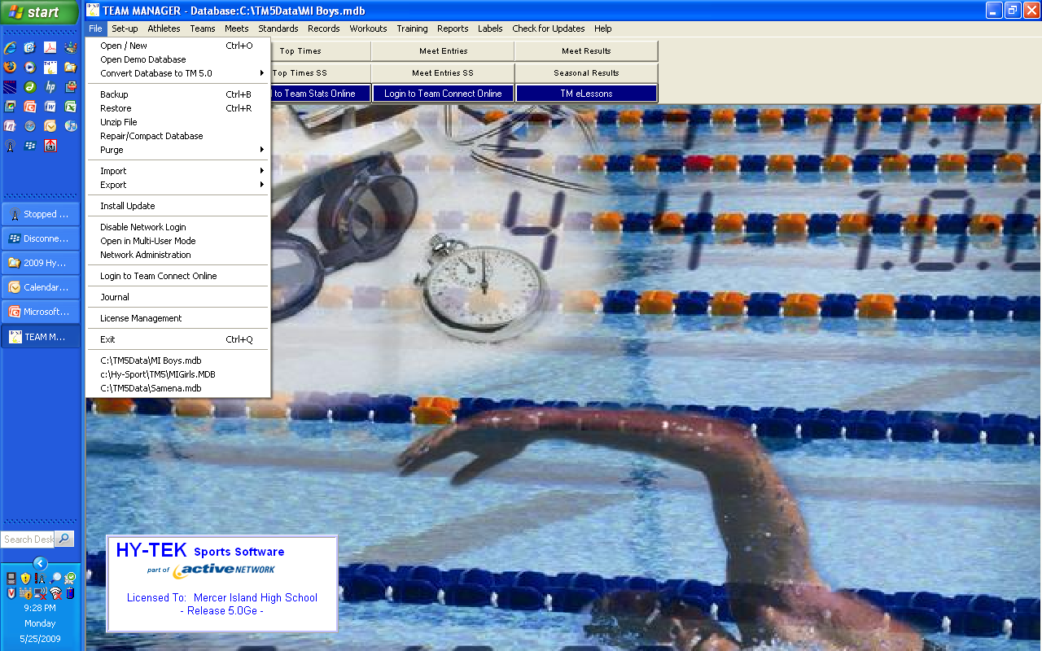
To create your teams database go to File/Open/New.
  In the box called File name type “Your team name”.
    This will create a fresh database for your team.

Slide 60
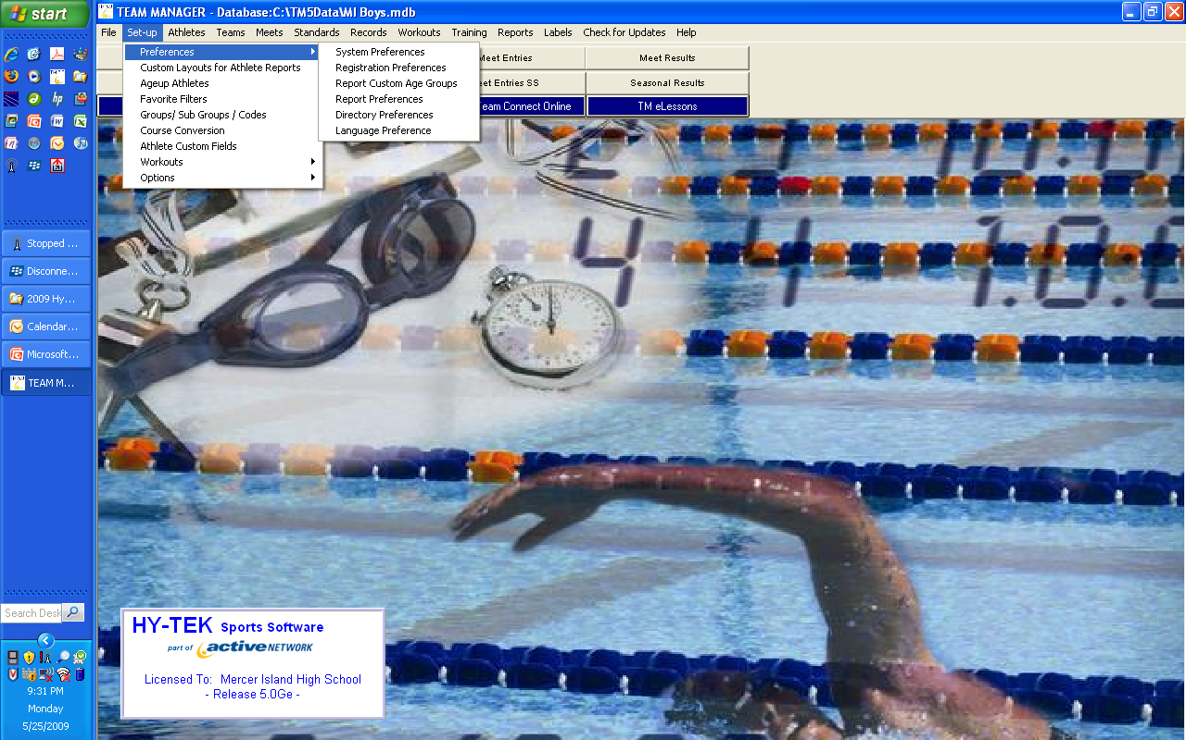
Age Up Dates
Meet – set for June 15, 2008
  ( this is something you will need to change each year)
System - set to June 15, 2008
  (This allows you to age-up the entire database each year by pressing the age-up button next to the date)
You will now be able to select the system preferences for your team.
  Default Team Registration to OTH
  Default Team Type to REC
  Default Country to USA
  Default State to WA
The Gender should be set to Boys/Girls. (common language)
In the Athlete Browser check off:
      show ages
      show birth date
      last name first
      use Relay lead-off splits
You are now done setting up your team database. To change go to Set-up/preferences/system

Slide 61
TEAM MANAGER offers literally hundreds of reports including:
Best Times,
Split Sheets to take to the meet,
Meet Eligibility,
Meet Results,
Mailing Labels,
Entry Cards/Labels,
Award/Improvement Labels,
3D Graphs,
Rosters,
Registration,
High Point,
Predict Results,
Records and Time Standards,
Meet Entries, and
Meet Entry Fees Report.
TM exports information to:
Excel,
Word,
HTML for the Web,
character delimited files,
and even exports Athlete names and their e-mail addresses directly to Outlook Express.
Tech Support - And most importantly, when you purchase TEAM MANAGER, you also receive, at no additional charge, Hy-Tek's acclaimed Tech Support services including Telephone support and Email support.

Slide 62
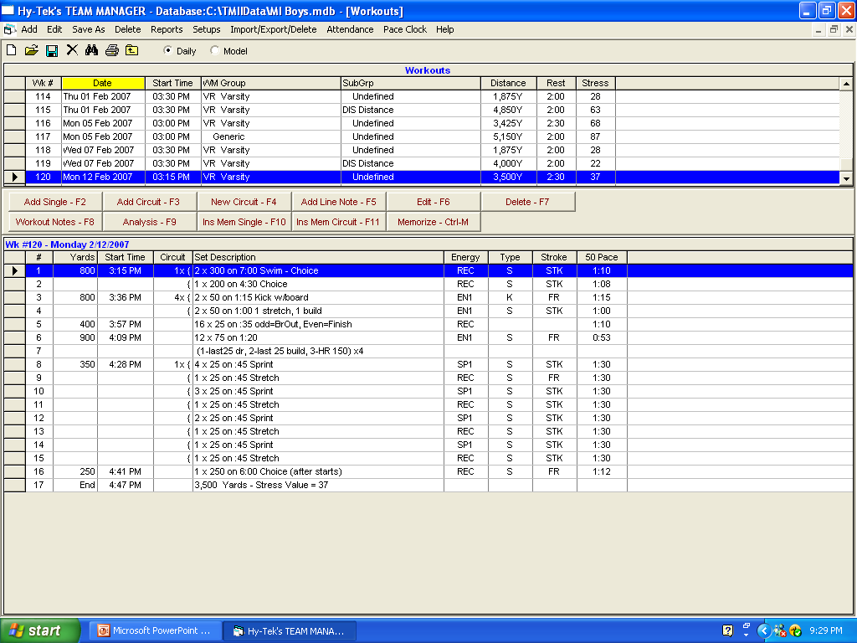
Team Manager with Workout Manager allows a coach to type and print workouts. These can be stored from year to year.

Slide 63
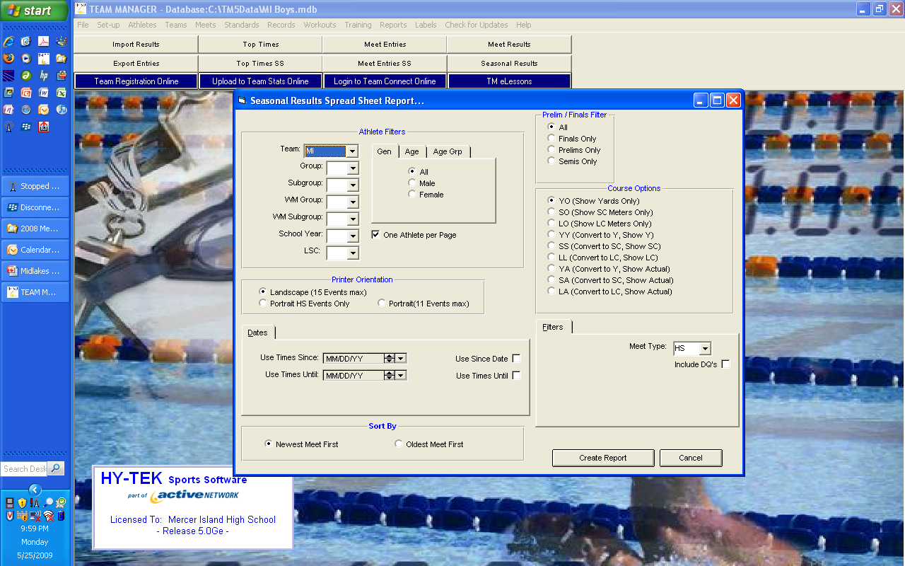
This spreadsheet allows a coach to give each athlete a report of their times that is specific to the current season. The report shows each meet individually.

Slide 64
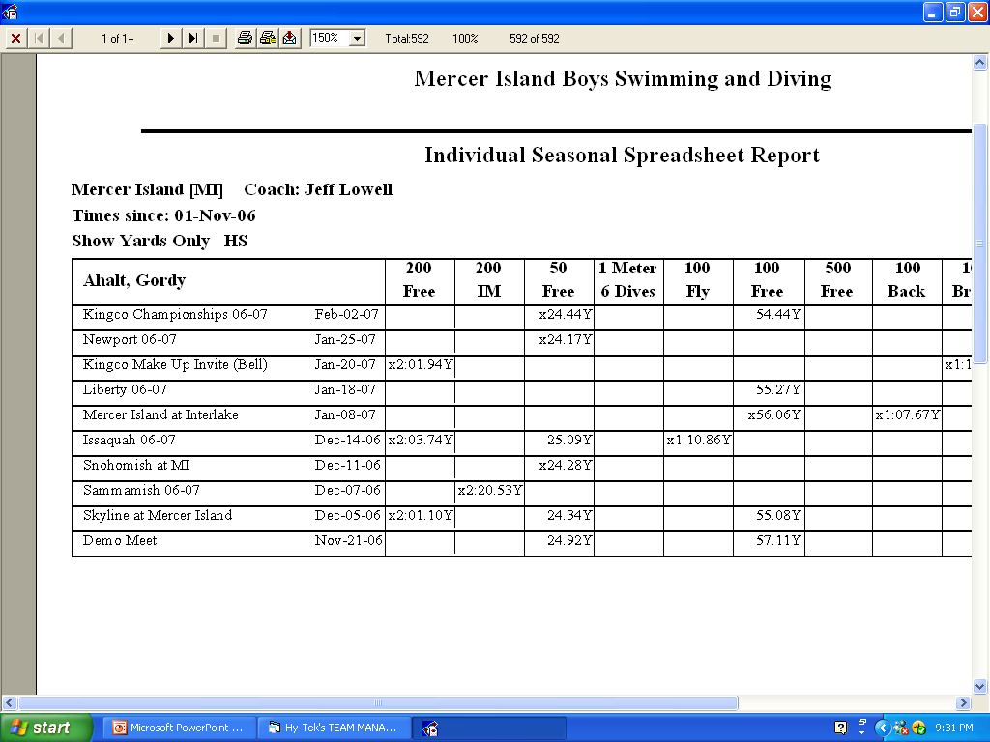

Slide 65
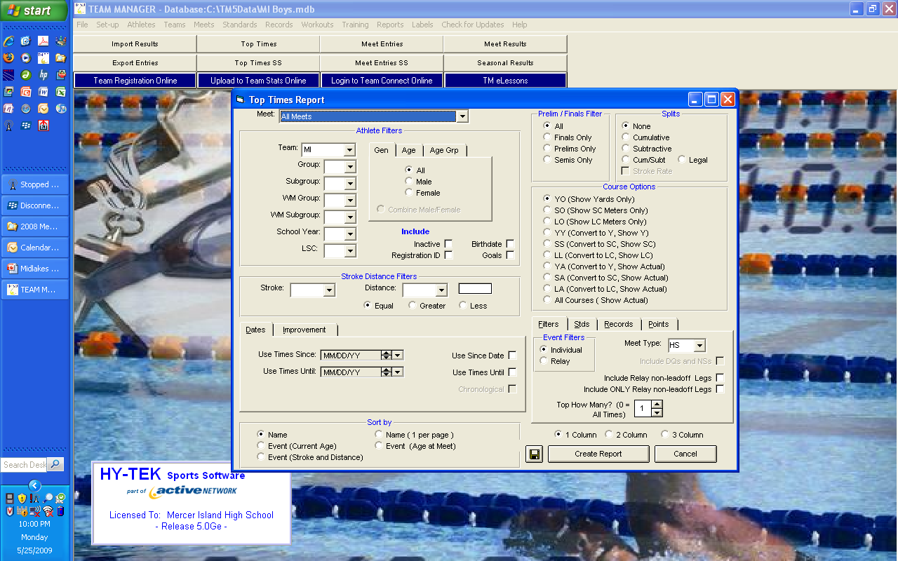
Be sure to hit YY if you have competed meters in order to get converted times considered.
Also choose O for Top How Many to get all times.
Again – use the since date to get this years times.
The top times report gives a listing of the best times for each event by age group.

Slide 66
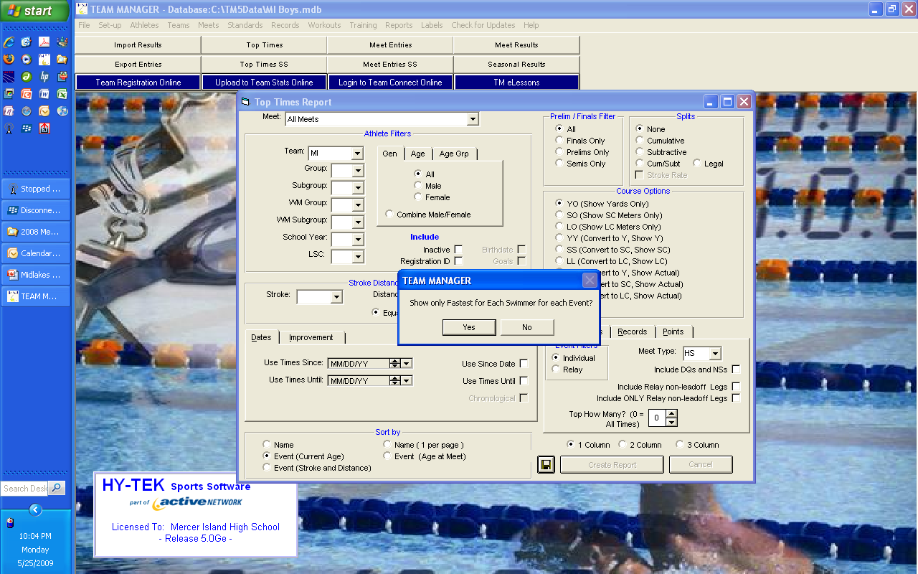
Be sure to select yes when it asks if you want to see the Fastest only – otherwise a swimmer will have multiple times on the list.

Slide 67
